Slide 1



Ionic PMJ
01 Pemula Ionic Capacitor
bit.ly/fstmkuis

Slide 2
Ionic PMJ
02 Ubahsuai Projek Ionic
dengan input HTML

Slide 3
Ionic PMJ
03 Borang input Angular
& TypeScript

Slide 4
Ionic PMJ
04 Pilihan (if...else), Tatasusunan Gelung (Array Loop), Typescript/Angular

Slide 5
Ionic PMJ
06 Set tetapan
firebase dalam Ionic
& rekod baharu

Slide 6
Ionic PMJ
07 Senaraikan dari
Firestore ke Ionic

Slide 7
Ionic PMJ
08 Carian Firestore guna SearchBar Ionic

Slide 8
Ionic PMJ
09 Kemaskini rekod
guna Ionic Component

Slide 9

Schedule
Day1: Intro to Ionic, HTML Angular,
Tabs, Cards Layout, Buttons, Labels, Inputs
TypeScript: pembolehubah, sintaks
If..else in typescript & angular
Repetition
Functions in Typescript
Page navigation
Day2: Online database with Firebase

Slide 10
OVERVIEW
TO IONIC FRAMEWORK

Slide 11
What is Ionic?
Ionic Framework is an open source UI toolkit for building performant, high-quality mobile and desktop apps using web technologies (HTML, CSS, and JavaScript).

Slide 12
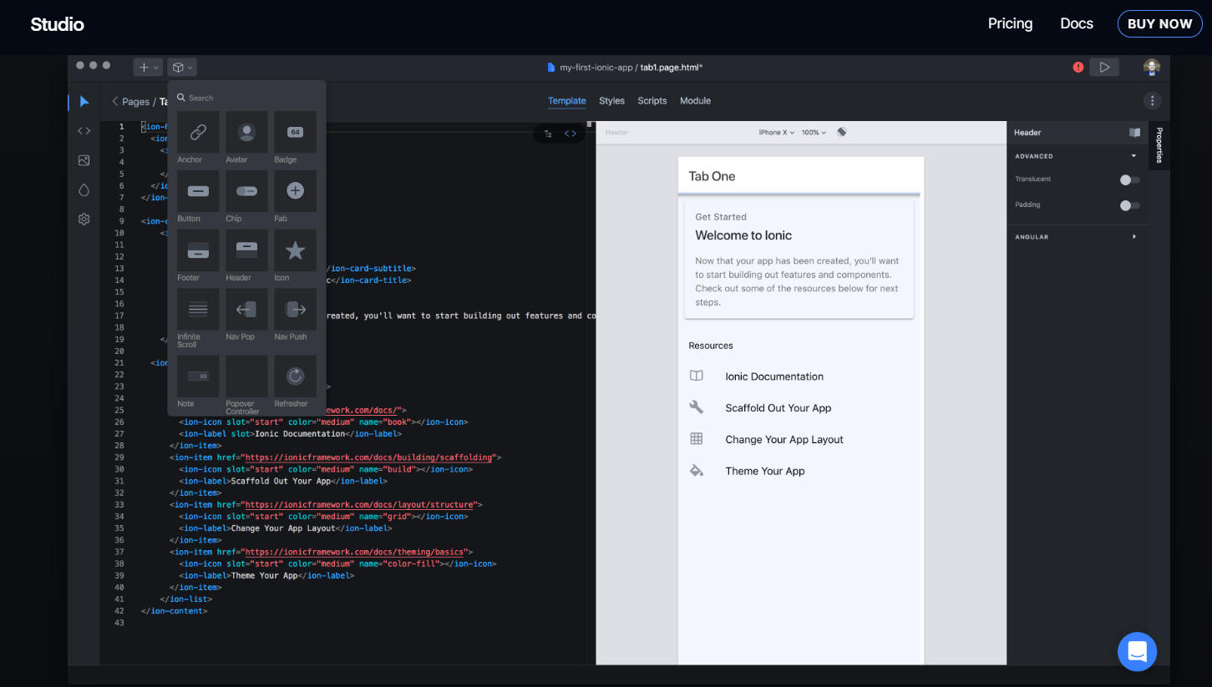
IonicX

Slide 13
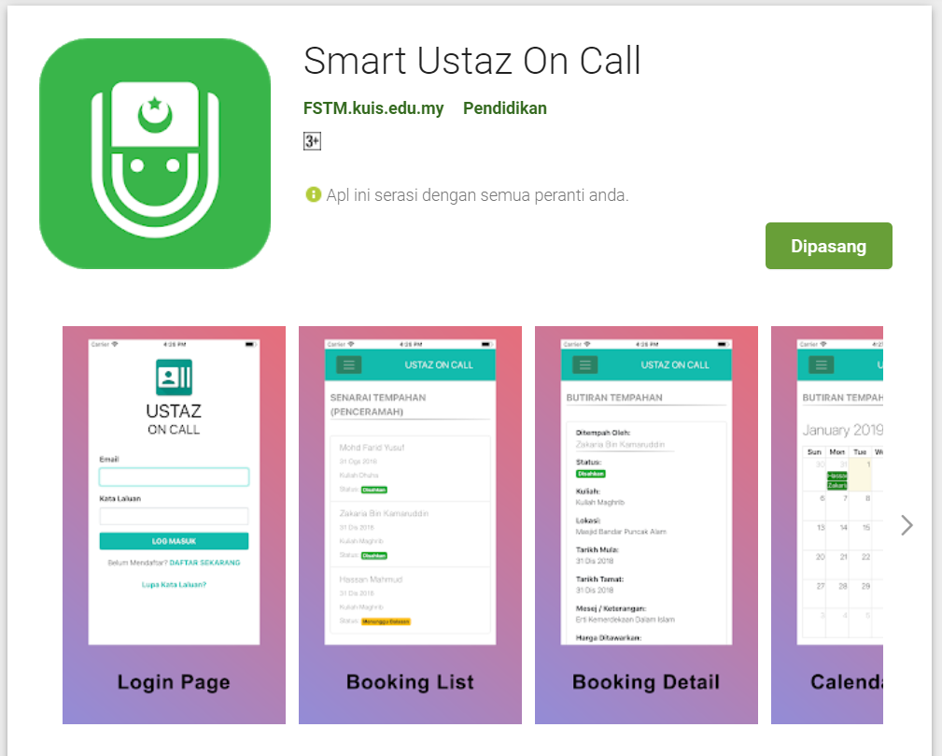
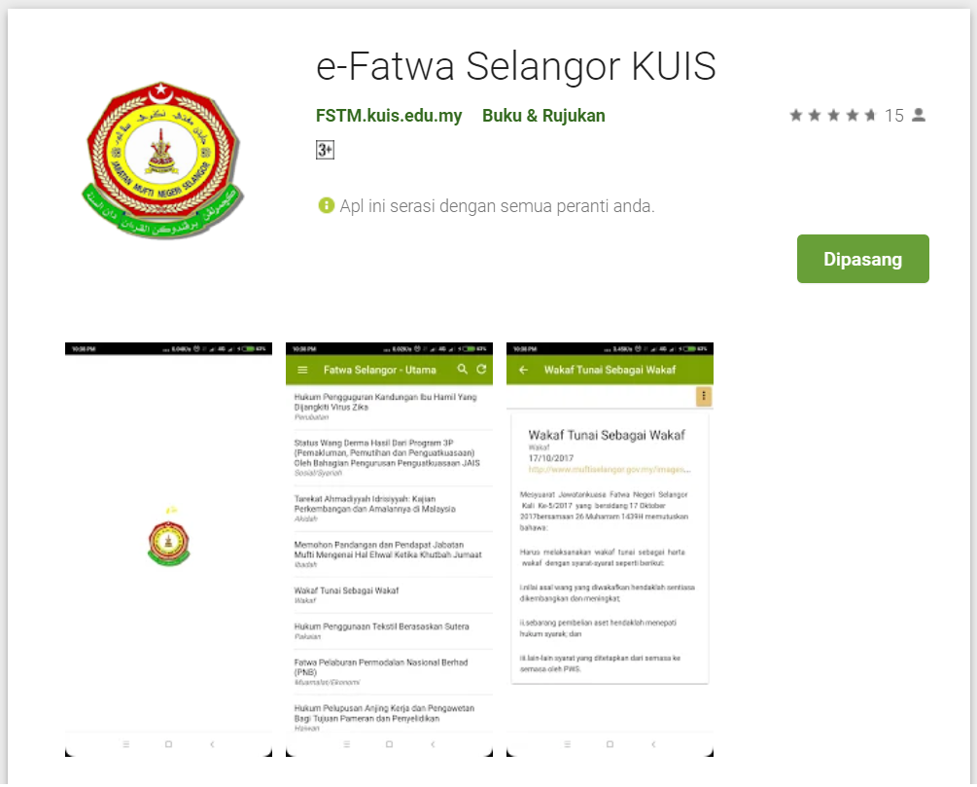
Available apps

Slide 14
IOS & Android Software Development
In a nutshell

Slide 15





Android Studio
(Java & Kotlin)
Android Device
NATIVE - 2 X WORK
XCode (Swift & Objective C)
iPhone/iPad

Slide 16

1 x WORK
Compile with Android SDK
Android Device
Cordova + Capacitor
Hybrid
XCode Project
iPhone/iPad

Slide 17
Cordova
Framework
Hybrid
WEB LAYER
NATIVE APP

Slide 18
1 x WORK
Build Progressive Web Apps
Android Device
Build Progressive Web Apps
Cordova
Framework
Hybrid
iPhone/iPad

Slide 19


1 x WORK
Android Studio
Android Device
+
XCode
iPhone/iPad

Slide 20
https://capacitor.ionicframework.com/

Slide 21



WHY IONIC?
Framework specifically to develop apps
Multiple platforms-Android, IOS, Windows, Amazon etc
Apps development using HTML & Typescript (subset of Javascript)
Plugins (camera, thumbprint, bluetooth, printer etc etc etc)

Slide 22
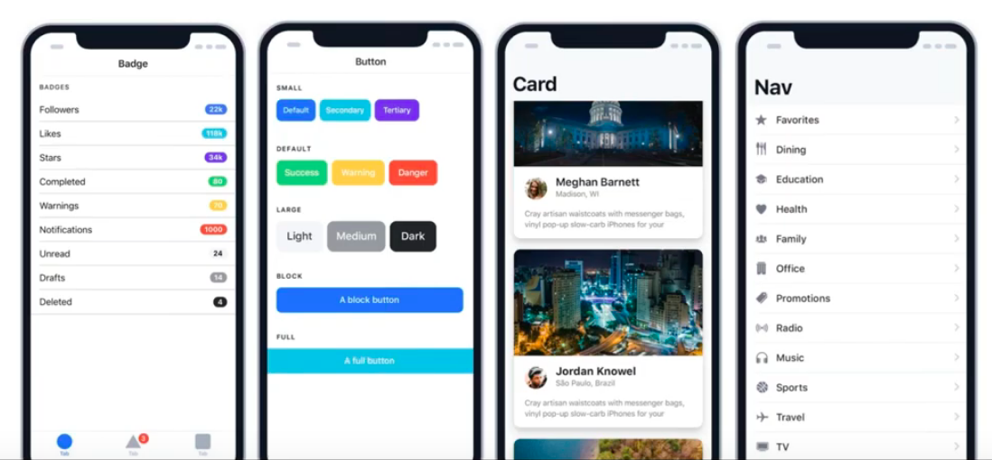
WHY IONIC?
Large COMMUNITY for support
Pre built gestures & animation
100+ UI Components
Everything is OPEN SOURCE
Built with Ionic

Slide 23
Software to start Ionic?

Slide 24
What do you need?
To run IONIC:
Node Package Manager (NPM)
Ionic Cordova Framework
Google Chrome Web Browser
To develop/publish app
VSCode OR any other IDE (with Typescript Plugin)
Ionic Capacitor
Android SDK or Xcode - can be done later

Slide 25

Download from nodejs.org
Download and install the NODEJS LTS version 14
http://nodejs.org

Slide 26
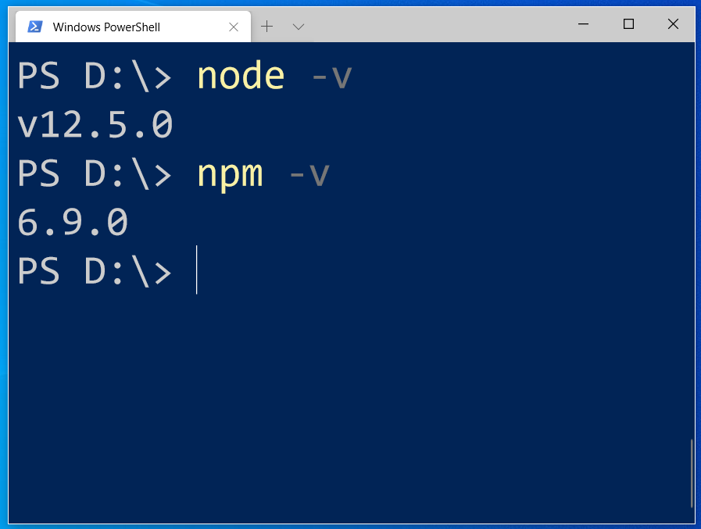
After install NodeJS from nodejs.org
node -v
npm -v

Slide 27
2. From command terminal run:
npm install -g @ionic/cli

Slide 28
Now, let’s install the tools

Slide 29
Install VSCode/sublime
NodeJS
Tutorial is here bit.ly/ionickerul
Install Google Chrome Browser
(If you don’t have, you should)

Slide 30
Before we start coding, some basic stuff...

Slide 31
-HTML?
-CSS ?
-TypeScript ?

Slide 32
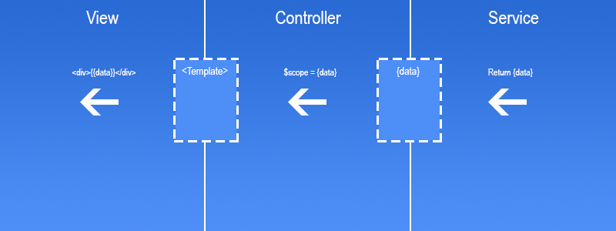
Simple MVC in Ionic
.HTML | .TS | services .TS /Model

Slide 33
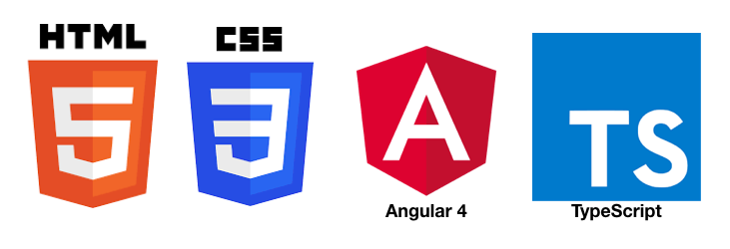
HTML
-Hyper Text Mark Up Language (HTML)
-Used to display the interface
-Write in tags,
-Example- <strong>Hello</strong> → Hello
-Ionic has its own built in tags
<ion-list></ion-list>
<ion-item></ion-item>
<ion-grid></ion-grid>
-HTML in Ionic is “AngularJS Flavoured”
-Have to use Angular Syntax for data and clicks
-Example- (click), *ngFor etc

Slide 34
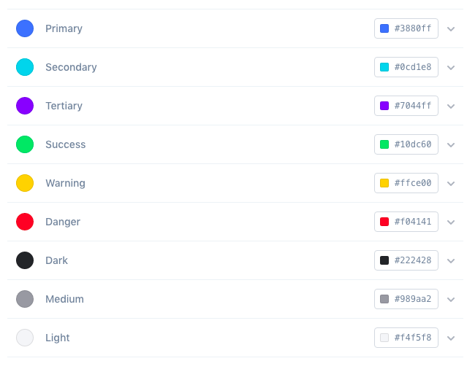
CSS or SCSS
-Cascading Style Sheets (CSS)
-Used for styling, very straightforward
-Each generated Ionic page comes with built in own CSS
-Can assist in ‘theming’ the app
-Ionic has standard built in colours
-Primary, Secondary, Danger, Light & Dark
Built in colours that can be added/edited

Slide 35
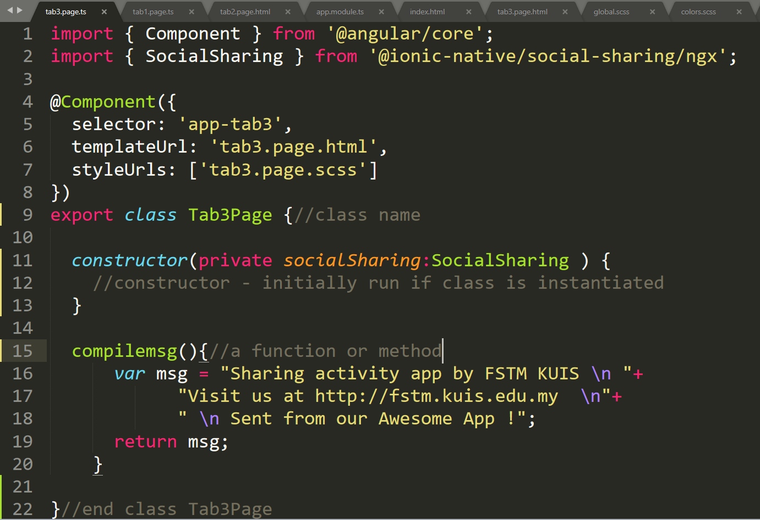
Class Function

Slide 36
Hello World ionic

Slide 37
1. Start a project
ionic start ionpmj tabs

Slide 38
2. CD into Directory & Run the project
ionic serve

Slide 39
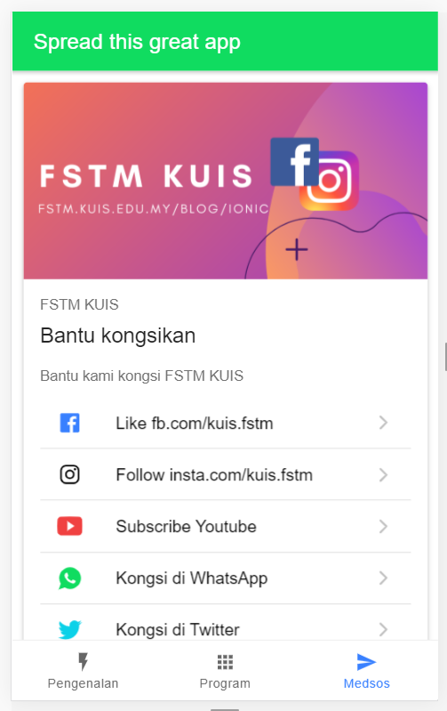
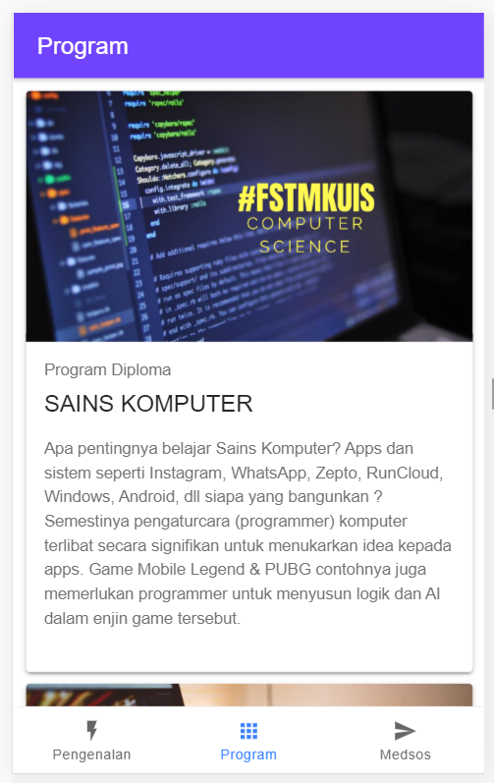
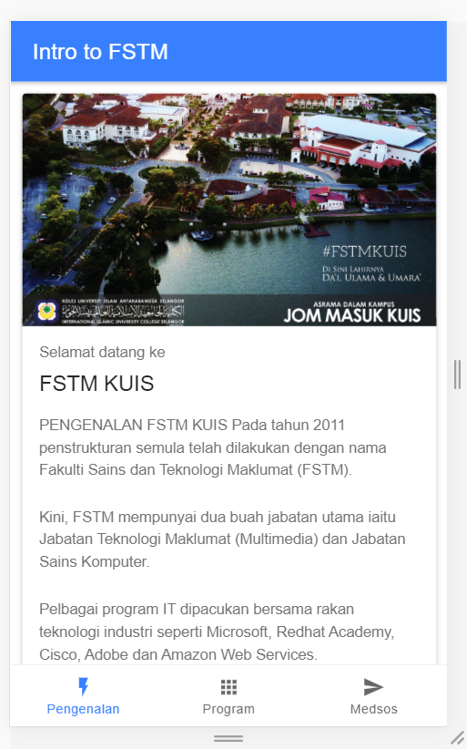
Next tab2 and tab3

Slide 40


T02 HTML interface
(antaramuka)

Slide 41
T02 Antaramuka
HTML
(sambungan bahagian2)

Slide 42
1. Start a project
ionic start appfstm tabs

Slide 43
2. CD into Directory & Run the project
ionic serve

Slide 44
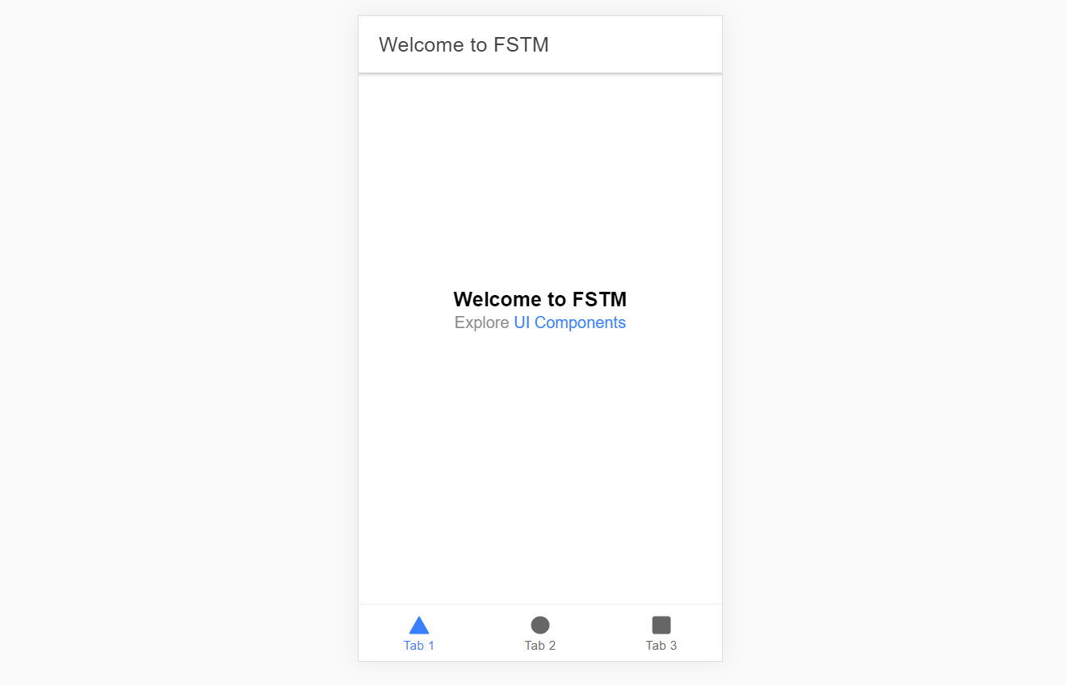
Output : ionic serve

Slide 45
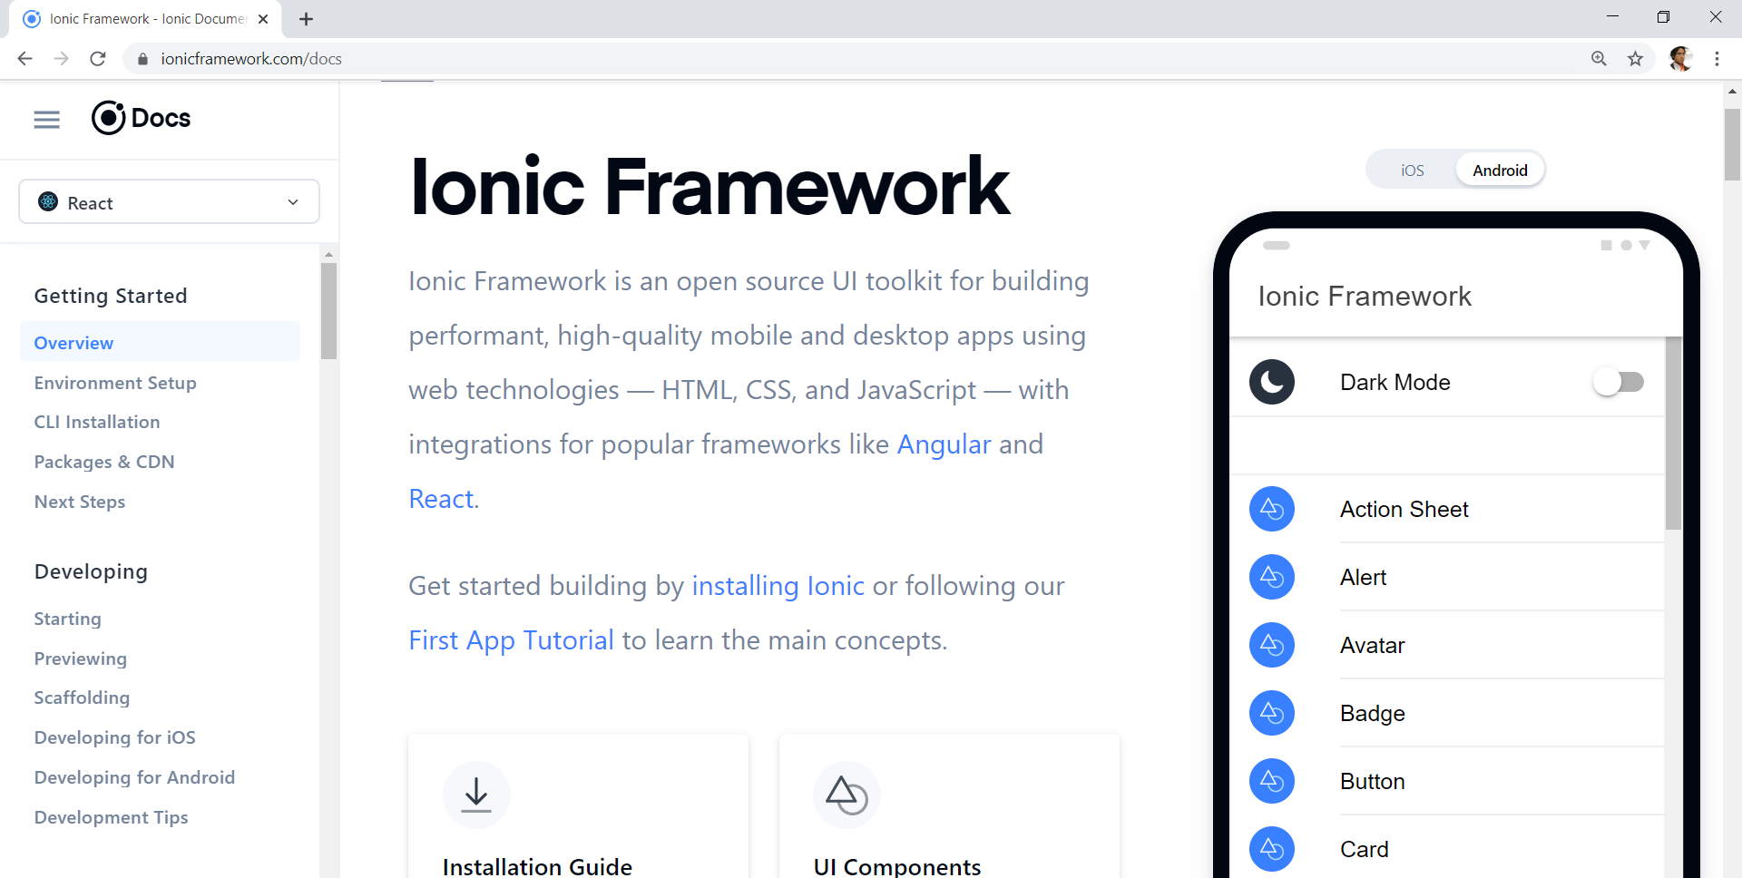
Always refer to documentations: https://ionicframework.com/docs

Slide 46
HTML
-Hyper Text Mark Up Language (HTML)
-Used to display the interface
-Write in tags,
-Example- <strong>Hello</strong> → Hello
-Ionic has its own built in tags
<ion-list></ion-list>
<ion-item></ion-item>
<ion-grid></ion-grid>
-HTML in Ionic is “AngularJS Flavoured”
-Have to use Angular Syntax for data and clicks
-Example- (click), *ngFor etc

Slide 47
CSS or SCSS
-Cascading Style Sheets (CSS)
-Used for styling, very straightforward
-Each generated Ionic page comes with built in own CSS
-Can assist in ‘theming’ the app
-Ionic has standard built in colours
-Primary, Secondary, Danger, Light & Dark
Built in colours that can be added/edited

Slide 48
Next tab2 and tab3

Slide 49
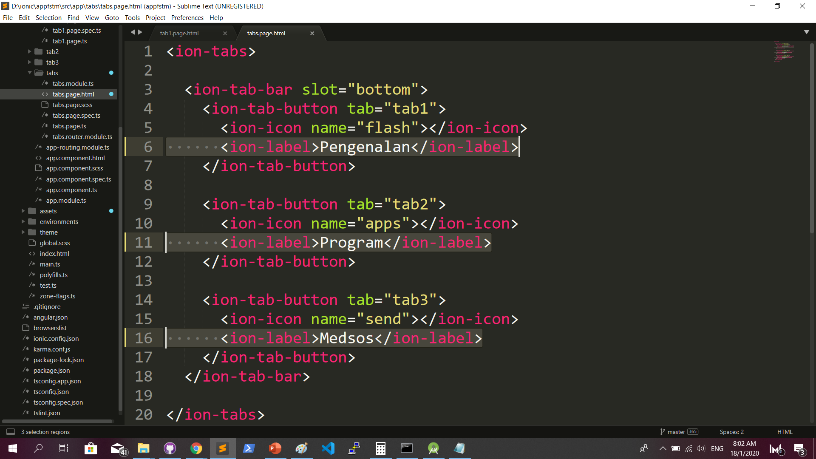
Some interface cosmetics: src/app/tabs/tabs.page.html

Slide 50
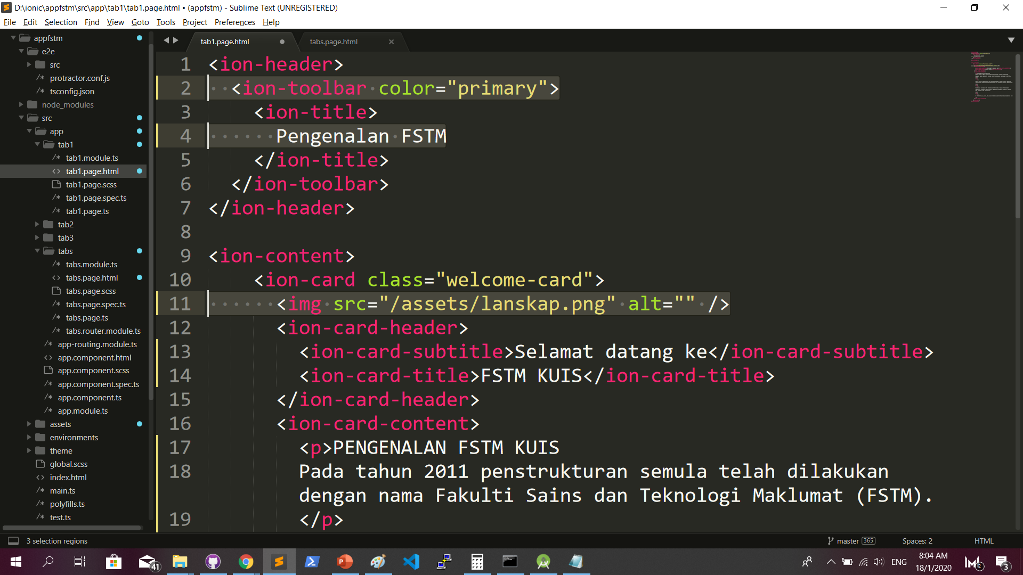
More interface cosmetics: src/app/tab1/tab1.page.html

Slide 51
Run ionic serve

Slide 52
Next tab2 and tab3

Slide 53
Codes & slides github.com/khirulnizam/ionic5

Slide 54
T03 Navigasi
(page navigation)

Slide 55
Page Navigation
+ routerLink (in .html) + NavController (in .ts)

Slide 56
routerLink in HTML
PAGE 1
PAGE 2
See app-routing.module.ts for page name

Slide 57
Exercise : Link to new page
Generate new pages
ionic g page info
ionic g page form

Slide 58
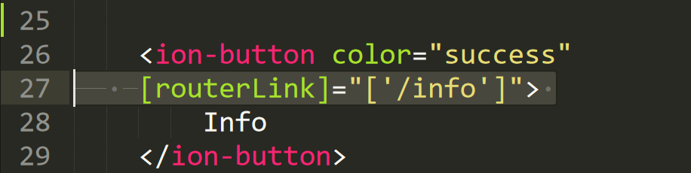
Exercise : Link to new page

Slide 59
NavController in TS
PAGE 1
PAGE 2
See app-routing.module.ts for page name

Slide 60
Add simple form interaction
+ Form Button + Alert function

Slide 61
Try building a button and make an alert
helloWorld(){
alert(“Hello Ionic!”)
}
<ion-button (click)=”helloWorld()”> ALERT </ion-button>
info.page.ts
info.page.html

Slide 62

Codes & slides github.com/khirulnizam/ionic5

Slide 63

T04 TypeScript

Slide 64
TypeScript
-A subset of Javascript
-Part of ECMA6 standard
-The ‘brains’ behind your app
-Used for processing & handling data
Example- calculation, accessing DB etc
-Ionic has standard built in to its TS:
NavController, ModalController etc

Slide 65
Typescript Syntax : Function
n1:number;
n2:number;
output:any;
addnumbers(){
output=n1+n2;
displayresult( );
}
displayresult( ){
alert(“Output: ”+output);
}

Slide 66
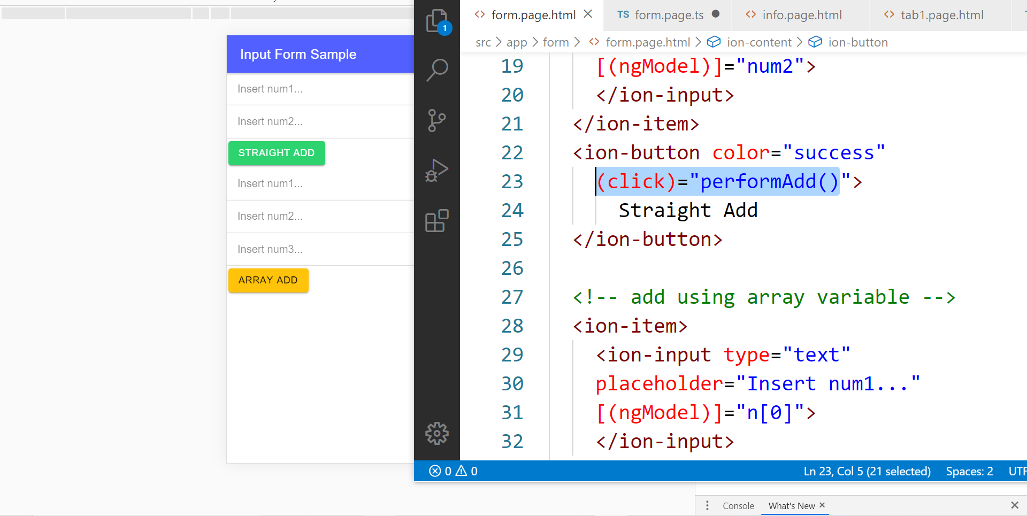
In file .HTML

Slide 67
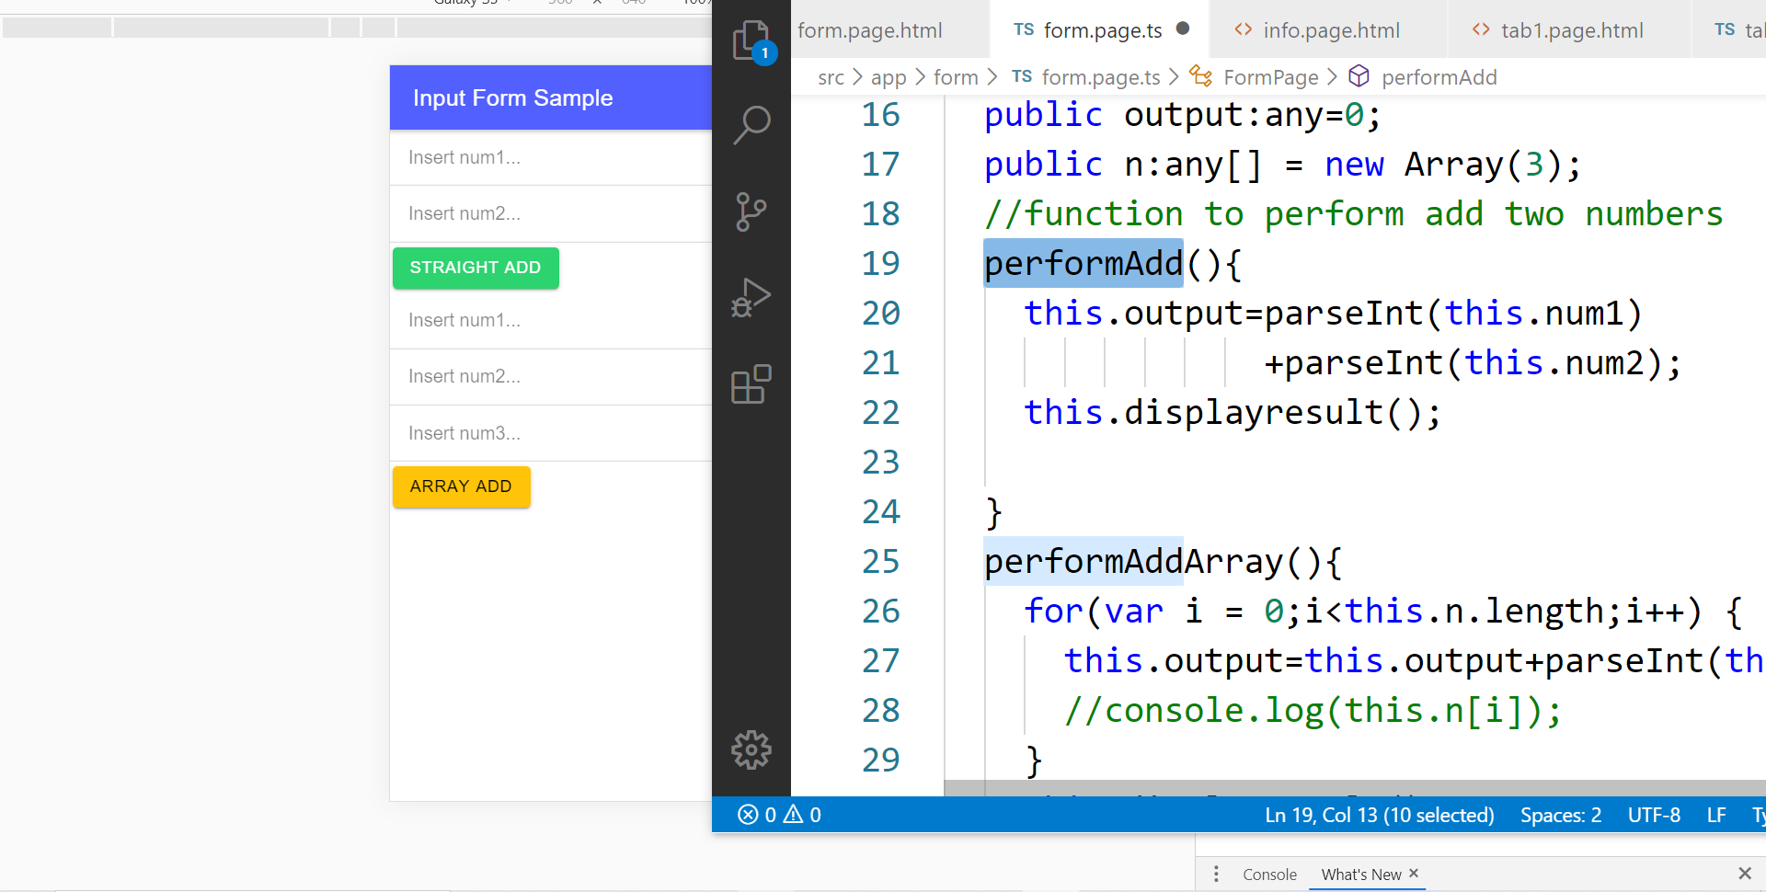
In file .TS

Slide 68
TypeScript Syntax : EX1 variable
What is a variable?
A variable acts as a container for values in a programming code.
var pi:number = 3.14;
Var num1:number=5;
var name:string =“enKerul”;
Use any to loosely-type the variable data type.
Data types:
any
can be numbers or strings
string
“this is string ” + “ concat ”
number
Double 3.14, or integer 5
array
can be a collection of Var, Strings or Objects

Slide 69
Typescript Syntax : EX2 String manipulation & Casting
//to convert String to number
var str = "54";
//easy way by using + operator
var num = +str; var num = parseInt(str);
String manipulation?
var str:string = "3.14";
var pi:number = 3.14;
console.log("pi is "+pi);
console.log("tau is "+(2 * pi));

Slide 70
Typescript Syntax : EX3 Array
Array? Array
can be a collection of Var, Strings or Objects
// A list literal.
var numbers = [4, 1, 5, 6, 3, 2];
for(var i=0;i<numbers.length; i++)
{
sum=sum+numbers[i]);
console.log(“Sum: ”+sum);
}
-----
Output
Sum: 21

Slide 71
Typescript Syntax : EX4 Associative array
Associative Array?
Array with key and value pairs (not index number).
// A map literal.
// Asociative array
var gases = [
'He': 'Helium',
'Ne': 'Neon',
'Ar': 'Argon’,
];
console.log(gases['Ne’]);
-------------------------
Output: Neon

Slide 72



T05 Kamera (installing camera plug-ins)

Slide 73
Codes & slides github.com/khirulnizam/ionic5

Slide 74
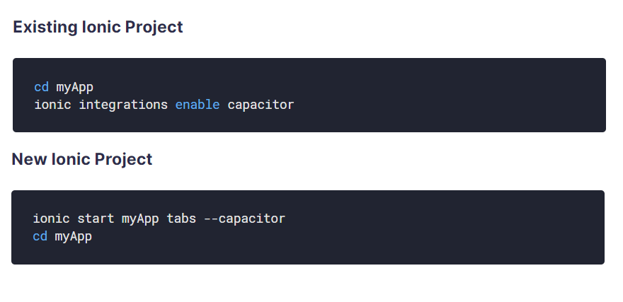
Using Capacitor with Ionic

Slide 75
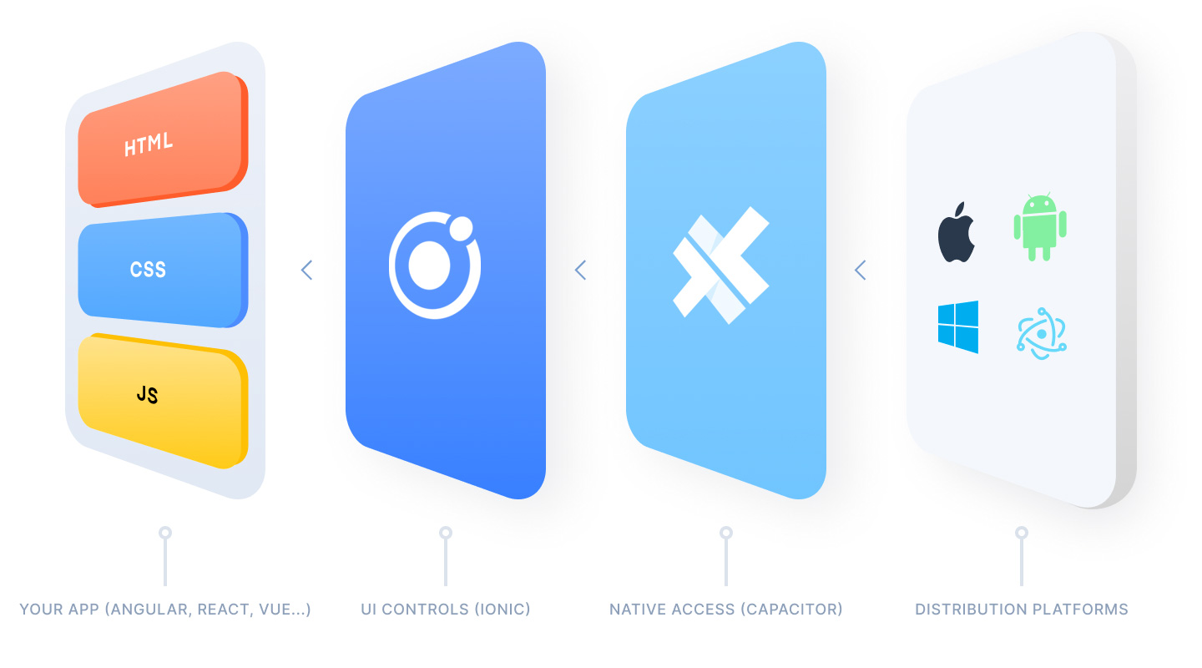
Ionic Capacitor
https://ionicframework.com/resources/articles/capacitor-vs-cordova-modern-hybrid-app-development
runs modern Web Apps natively on iOS, Android, Electron, and Web

Slide 76
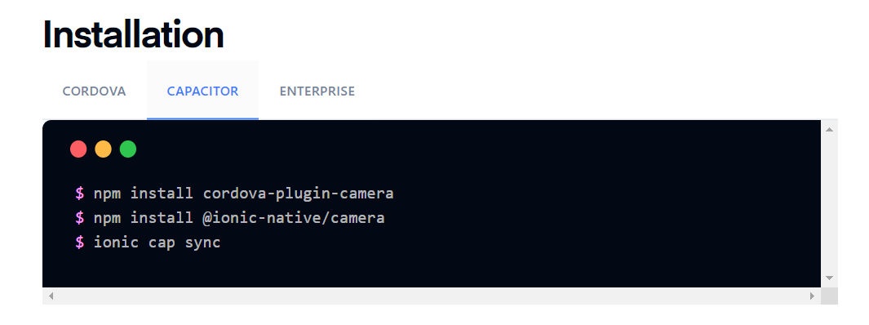
Install camera support : ionicframework.com/docs/native/camera

Slide 77
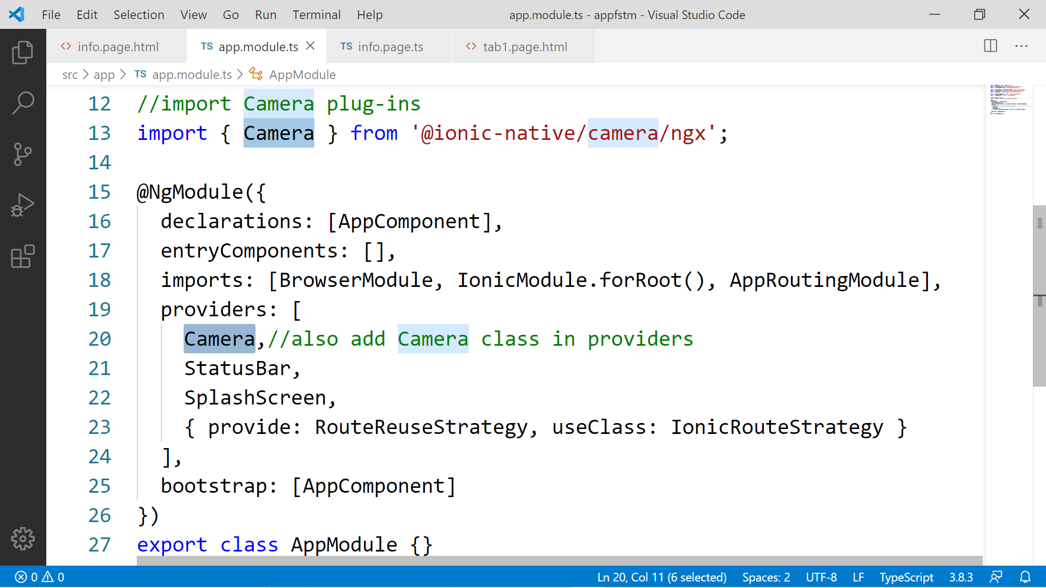

Slide 78
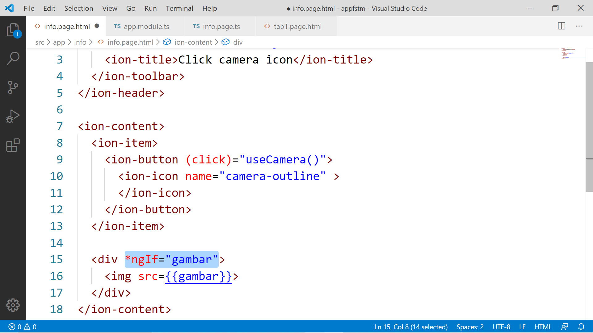

Slide 79
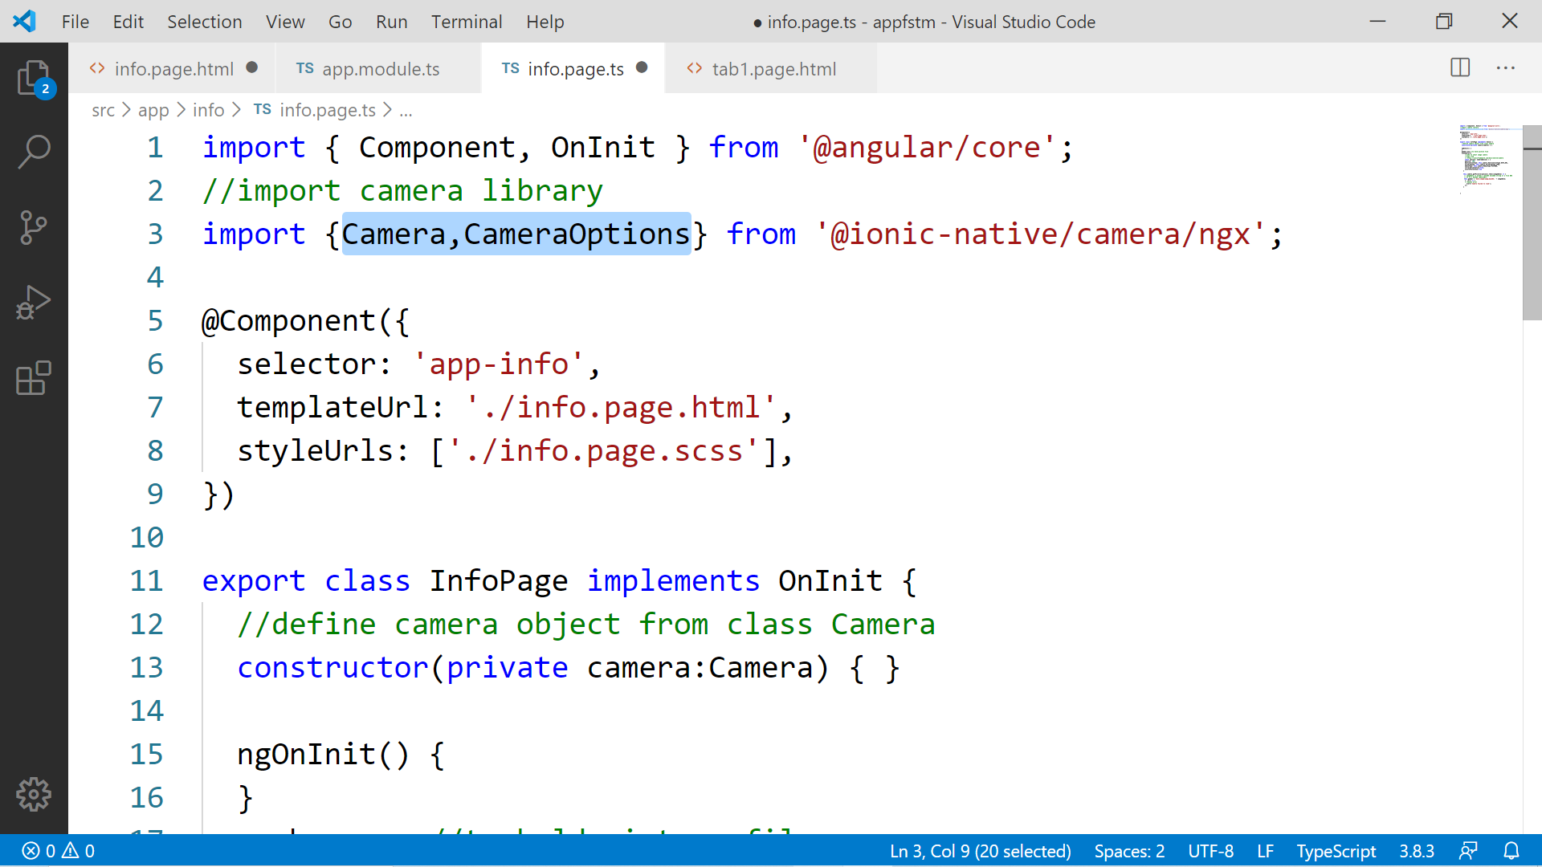

Slide 80
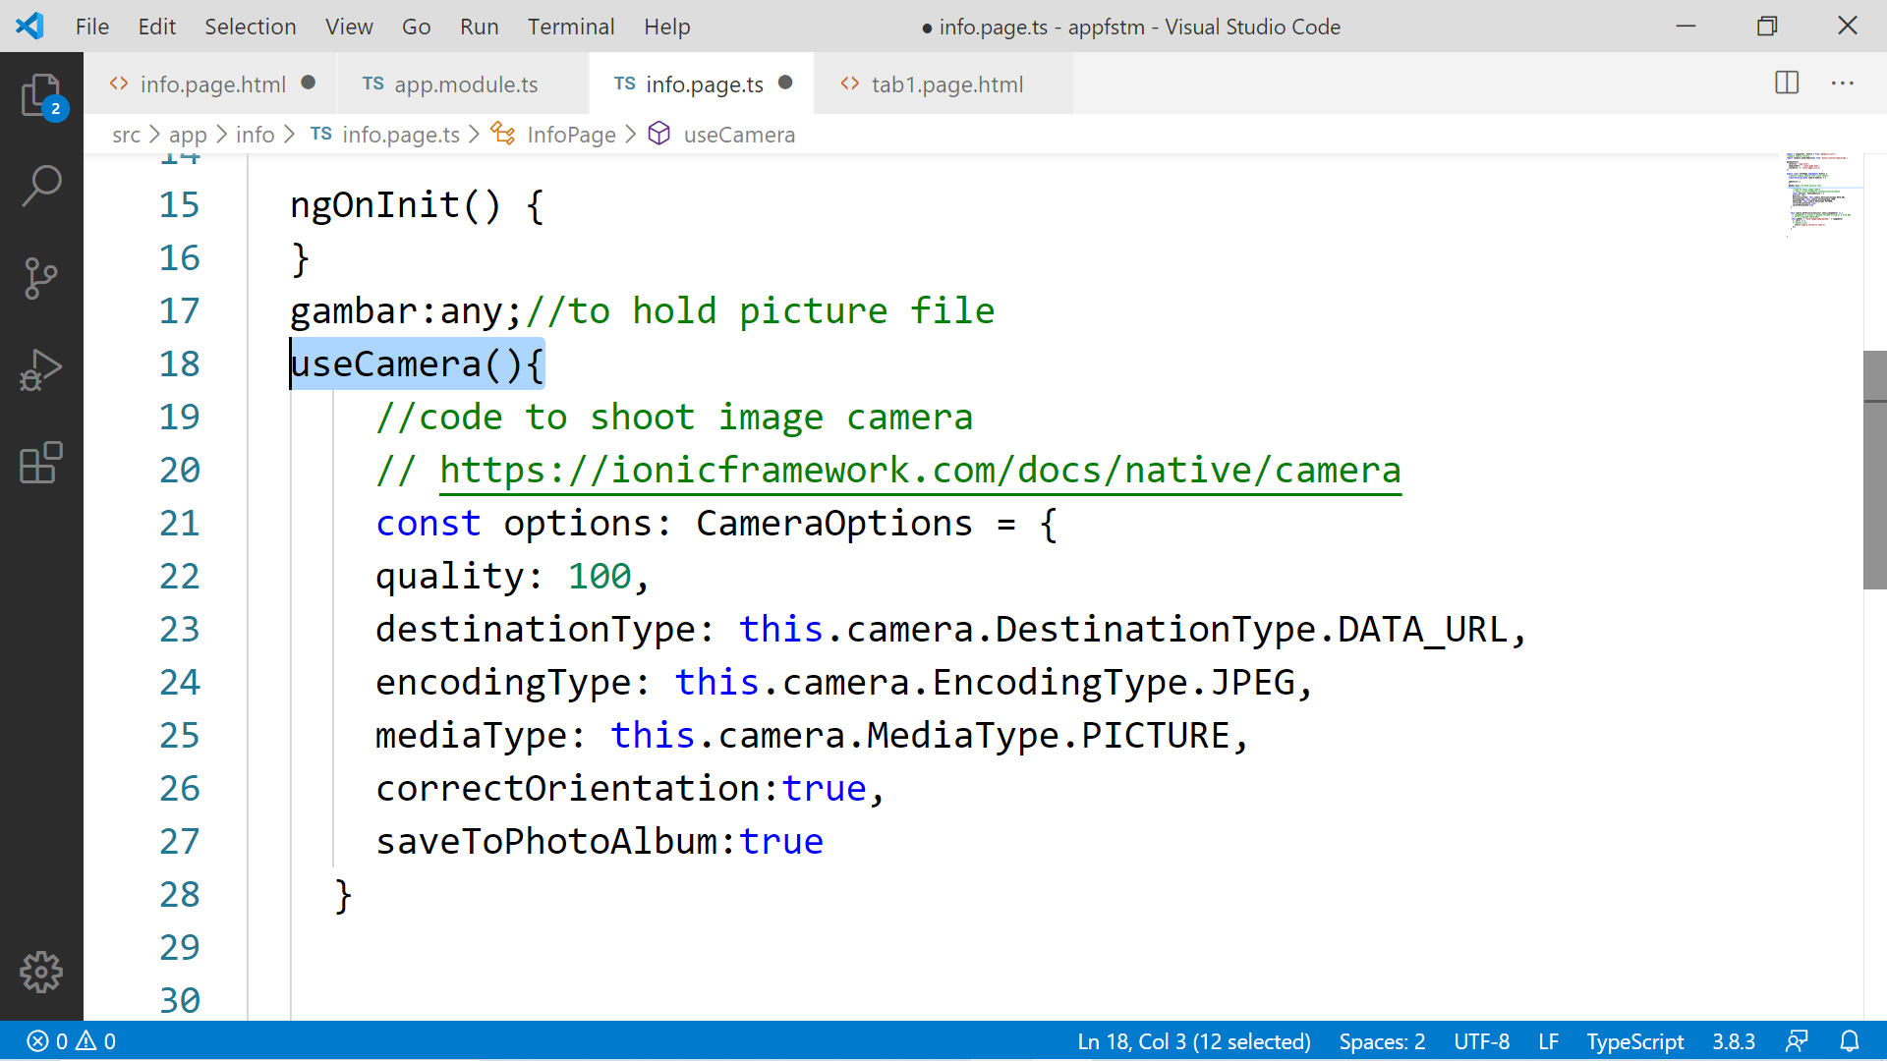

Slide 81
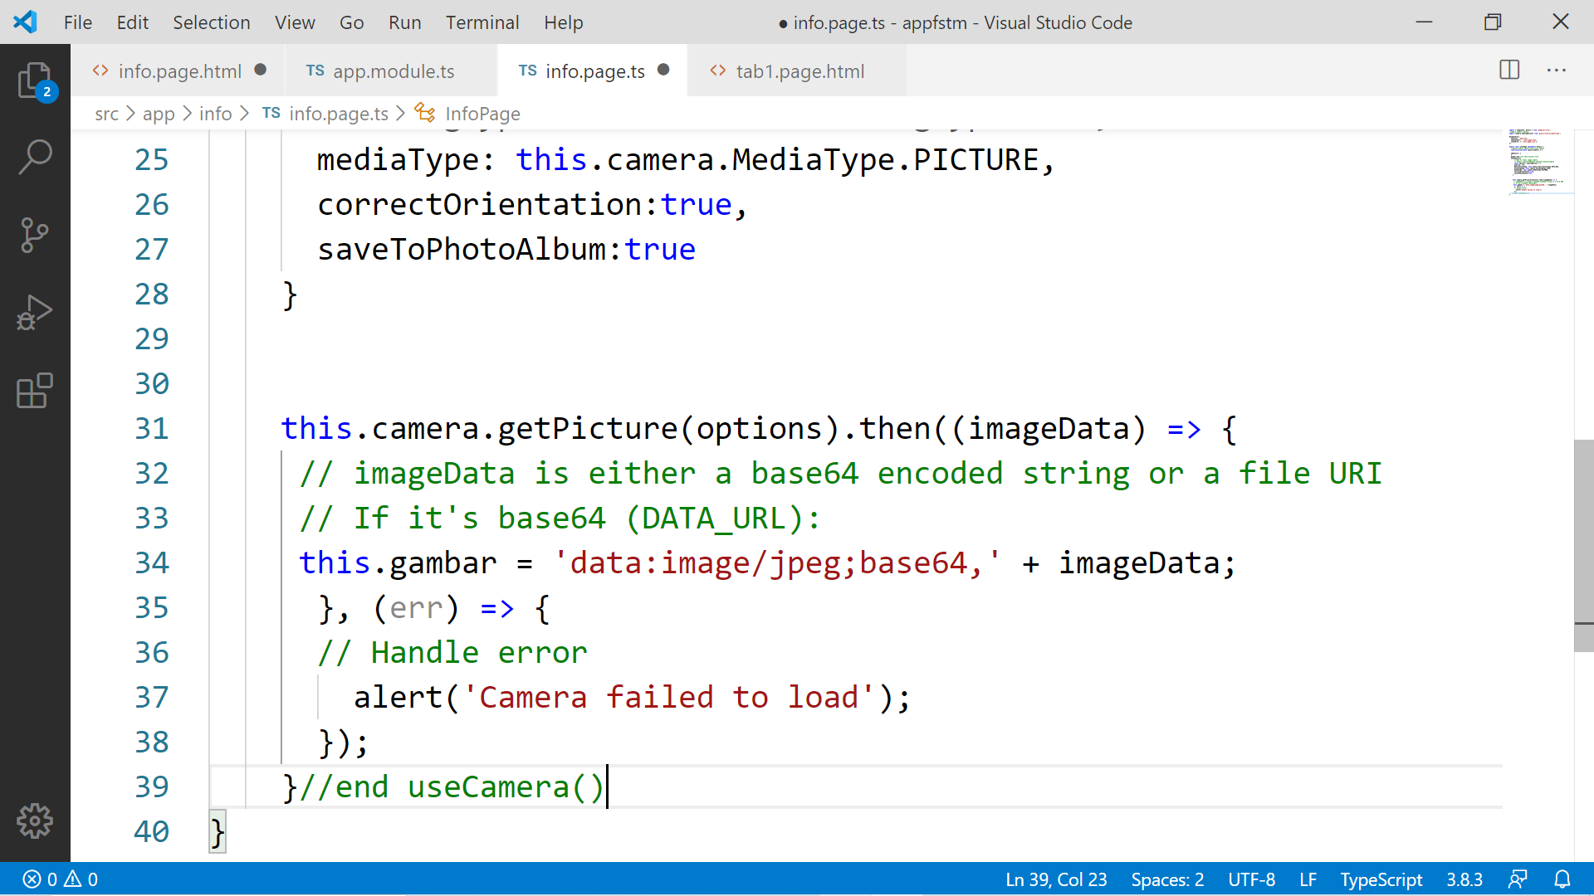

Slide 82
Migration Cordova to Capacitor - error: package android.support.v4.content does not exist
npm install jetifier
npx jetifier
npx cap sync android

Slide 83
Ionic Capacitor
https://ionicframework.com/resources/articles/capacitor-vs-cordova-modern-hybrid-app-development
runs modern Web Apps natively on iOS, Android, Electron, and Web

Slide 84
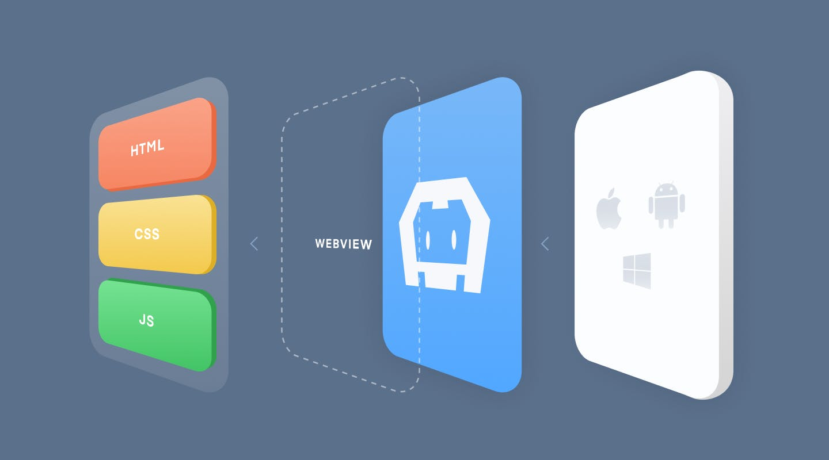
Previously we have CORDOVA

Slide 85
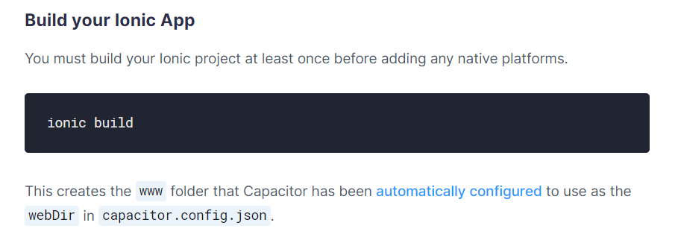
Ionic build

Slide 86
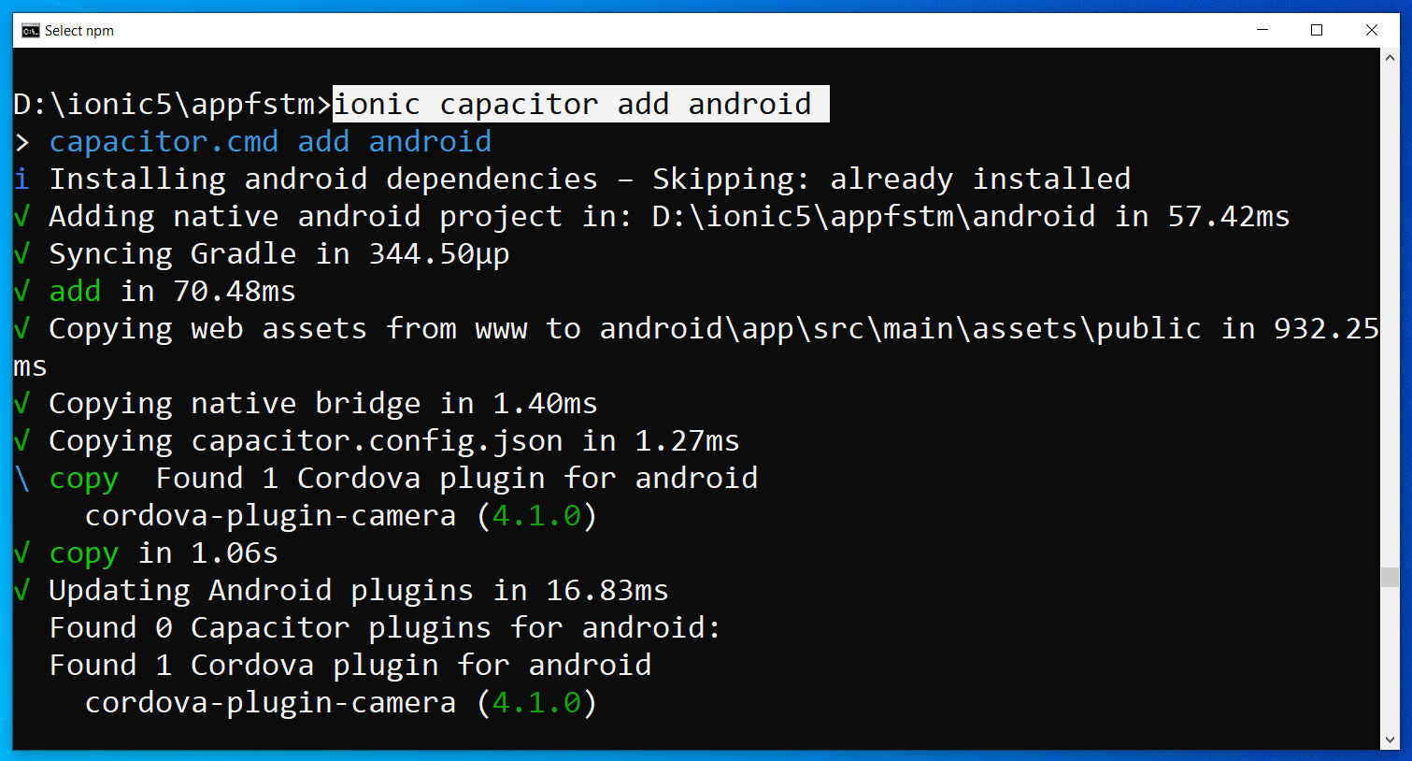
Run only once for each ionic project
To update Android project, execute
ionic build
npx cap copy

Slide 87
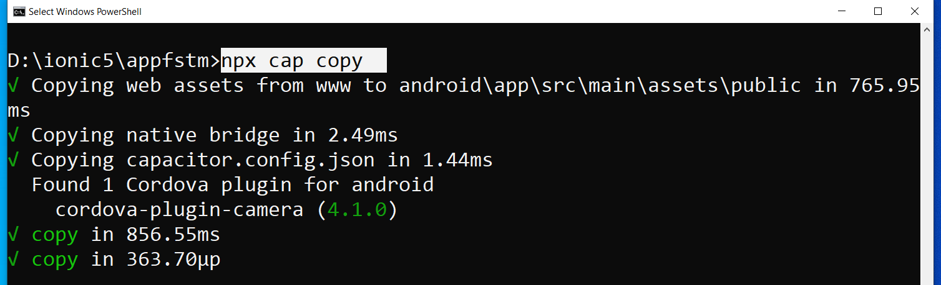
After finish installing the camera plug-ins

Slide 88
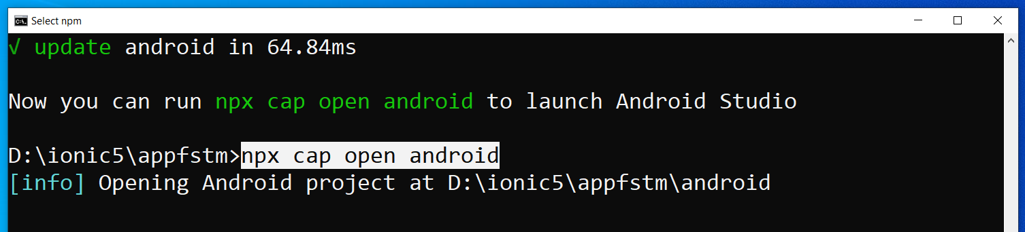
To open project on Android Studio

Slide 89
Codes & slides github.com/khirulnizam/ionic5

Slide 90
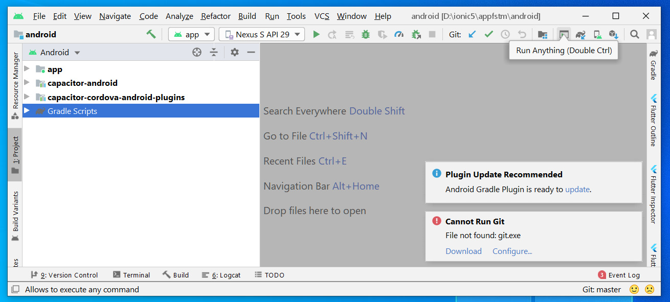
Open in Android Studio

Slide 91
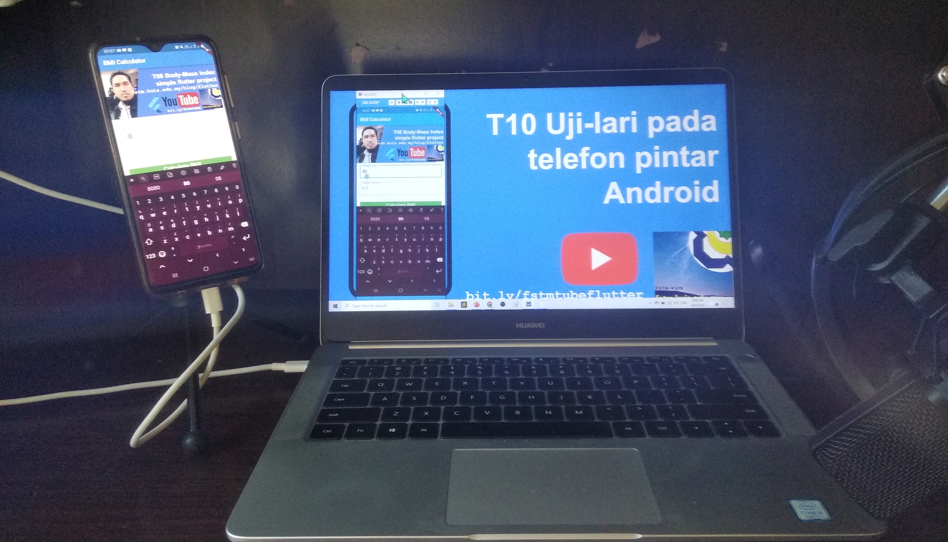


Uji-lari
apps pada
telefon
Android

Slide 92

Android Studio 3.6 & SDK developer.android.com/studio

Slide 93
Path settings (environment variables)
ANDROID_SDK_ROOT
JAVA_HOME

Slide 94
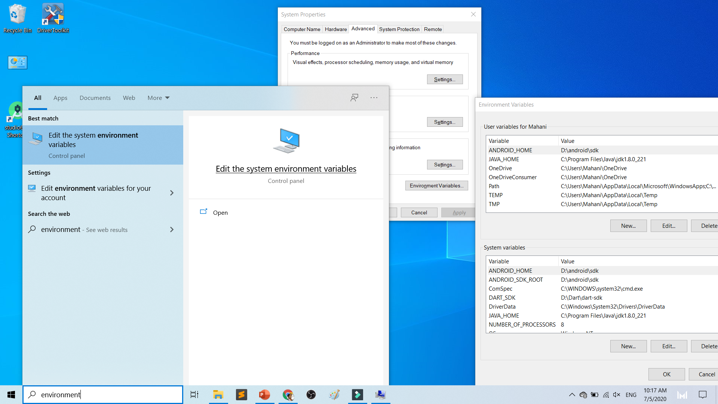

Slide 95
To deploy
Android Studio
Android SDK
Android Phone with USB Debugging enabled
ADB Bridge
USB Data-cable for Actual Device

Slide 96
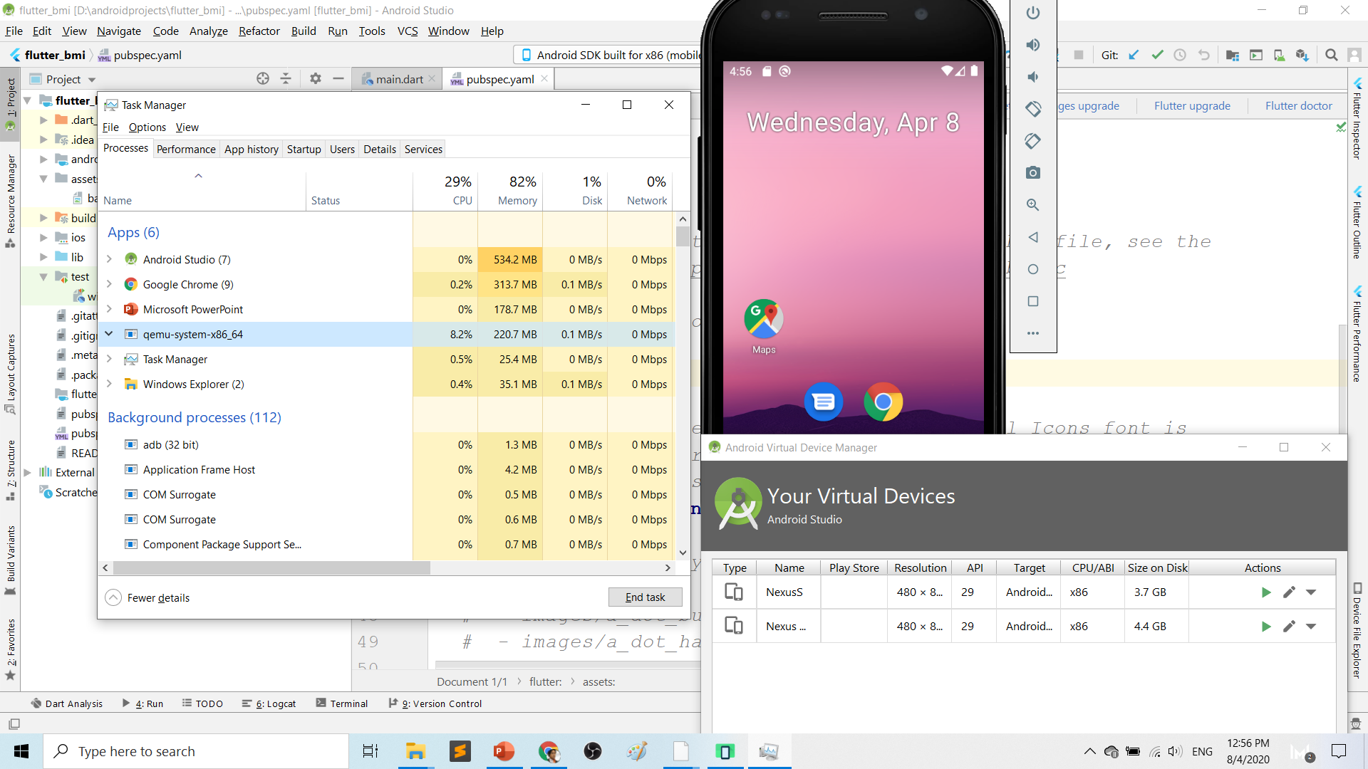
Play.google.com
What’s wrong with Android Studio & Emulator? RESOURCE-HUNGER

Slide 97
Requirements 1. USB debugging ON- phone 2. Connect USB Cable 3. Install ADB driver in PC

Slide 98
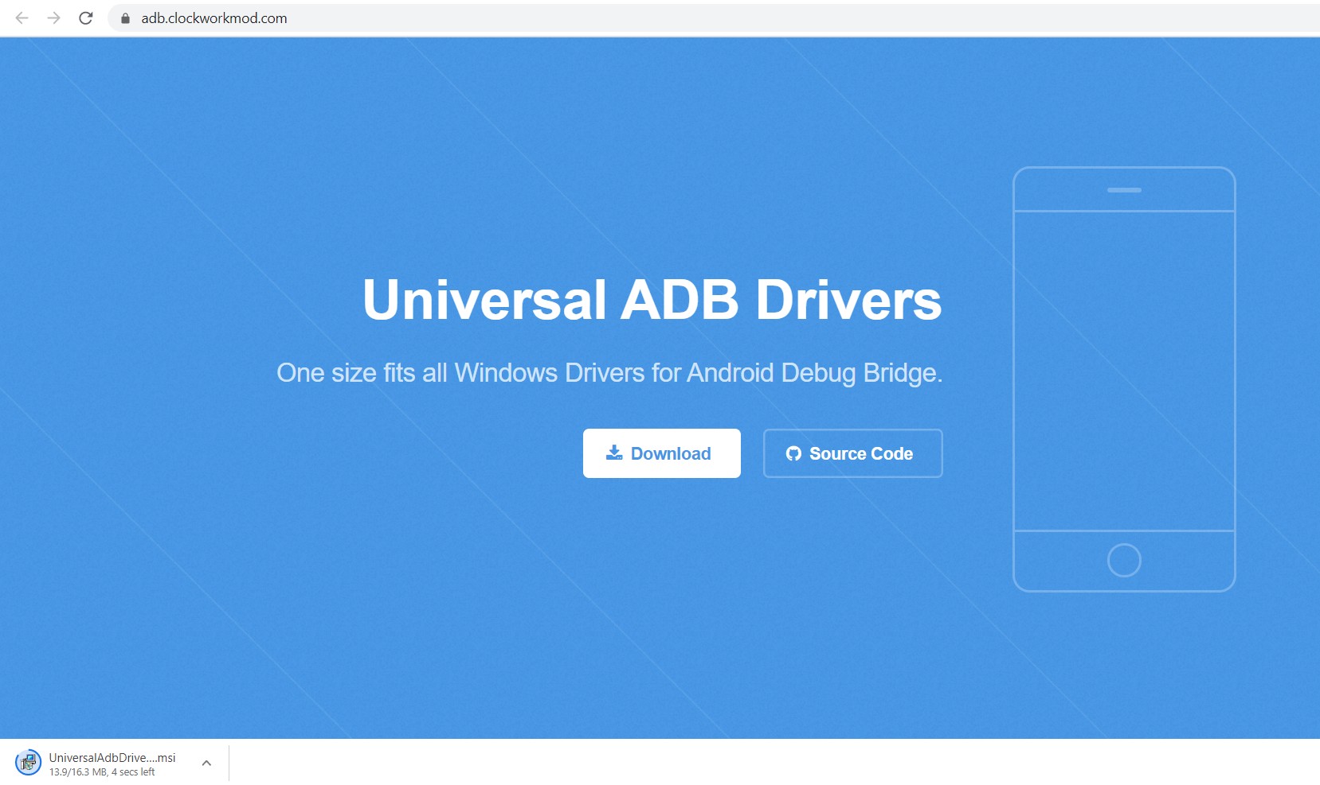
Play.google.com
Install universal debug driver
https://adb.clockworkmod.com/
Download & install universal debug

Slide 99
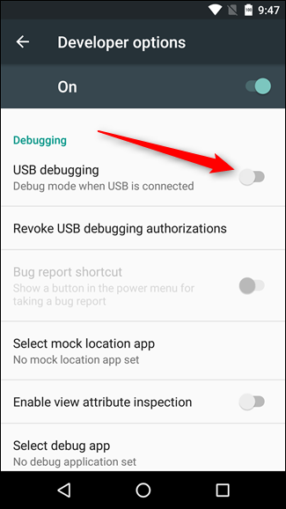
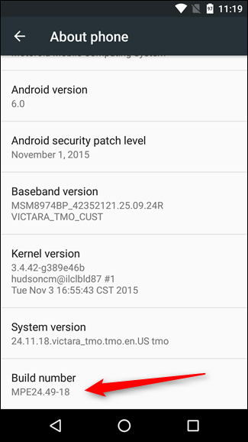
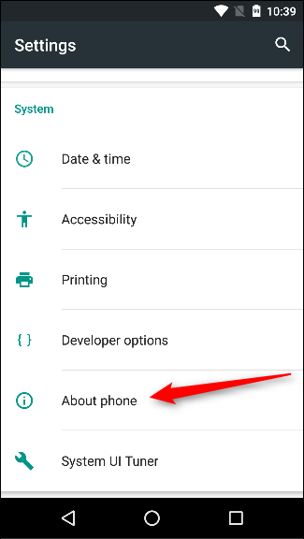
First time to on USB Debugging?
Developer options enable
Press 7X on build number
press 7x

Slide 100
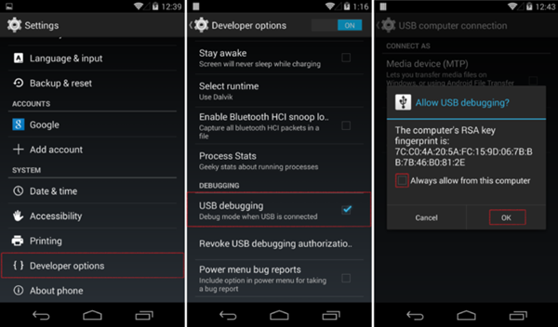
First time Allow USB debugging?

Slide 101
Ionic build

Slide 102
Create Android project/platform ionic capacitor add android
Run only once for each ionic project
To update Android project, execute
ionic build
npx cap copy

Slide 103
Copy to www to android project npx cap copy

Slide 104
To open project on Android Studio npx cap open android

Slide 105
Open in Android Studio

Slide 106
Codes & slides github.com/khirulnizam/ionic5

Slide 107


T07 Pilihan Selection : if…else, ngIf
Codes & slides
github.com/khirulnizam/ionic5

Slide 108
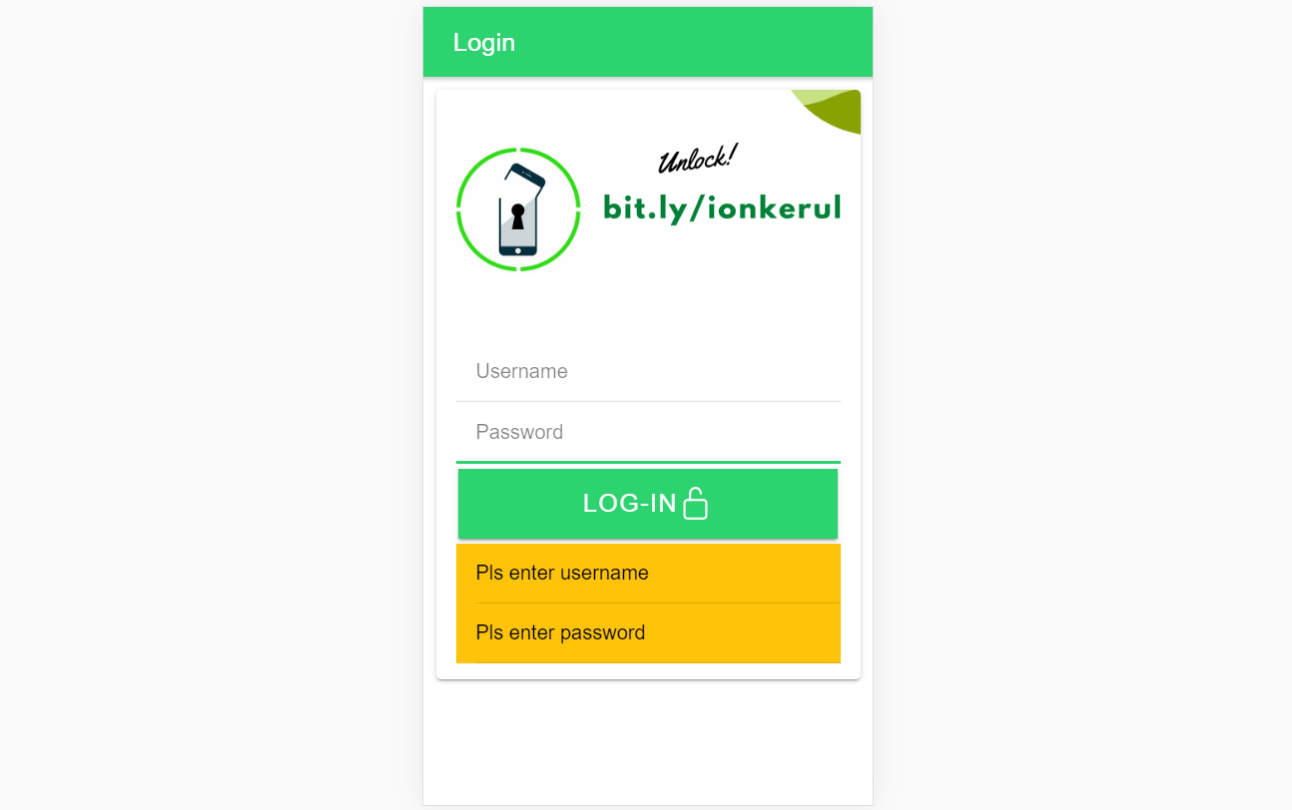
Output overview

Slide 109
Create a new page
ionic g page login
(selection exercise)

Slide 110
[(ngModel)]
Example:
IN TYPESCRIPT:
username:any;
password:any;
IN HTML:
<ion-input [(ngModel)]= “username”>
</ion-input>
<ion-input [(ngModel)]= “password”>
</ion-input>
[(ngModel)] USED IN HTML to capture what is typed into input to TypeScript

Slide 111
*ngIf used in HTML
Usually used for array iterations
Example:
IN HTML
<div *ngIf= “ username==null ”>
Pls enter username
</div>
<div *ngIf= “ password==null ”>
Pls enter password
</div>
*ngIf USED IN HTML

Slide 112
*ngIf … else used in HTML
<div *ngIf="gambar; else noImageYet">
<img src="{{gambar}}">
</div>
<ng-template #noImageYet>
<img src="./assets/noimagep.png">
</ng-template>
*ngIf … else USED IN HTML

Slide 113
IF...ELSE IF...ELSE AND *ngIFStatements
Usually used for selection and/or filtering
Example:
if(username== null){
alert(“Pls insert username”);
}
else if(password==null){
alert(“Pls insert password”);
}
else {
alert(“Welcome user”);
}
IF...ELSE IF..ELSE USED IN TYPESCRIPT IS EXACTLY THE SAME AS JAVASCRIPT

Slide 114
Output

Slide 115

T08 Ulangan Repetition : for, foreach, ngFor

Slide 116
Codes & slides github.com/khirulnizam/ionic5

Slide 117
Create a new page
ionic g page irepeat
(repetition exercise)

Slide 118
For Loop and *ngFor
Usually used for array iterations. Example:
negeri[0]= “Johor”;
negeri[1]= “Melaka”;
negeri[2]= “N. Sembilan”;
negeri[3]= “Selangor”;
for(var x=0;x<negeri.length;x++)
{
console.log(negeri[x]);
}
This will output in the console all the items in the array
FOR LOOP USED IN TYPESCRIPT

Slide 119
For Loop and *ngFor
Usually used for array iterations
Example:
IN TYPESCRIPT
negeri[0]= “Johor”;
negeri[1]= “Melaka”;
negeri[2]= “N. Sembilan”;
negeri[3]= “Selangor”;
IN HTML
<ion-item *ngFor= “let item of negeri”>
{{ item }}
</ion-item>
This will output all the negeris in HTML
*ngFor LOOP used in HTML

Slide 120

T09 Navigasi (navigation with parameters)

Slide 121
PARAMETERS
PAGE 1
(irepeat)
PAGE 2
(displayparams)
Nama: Kerul
Poskod: 43000
Negeri: Selangor
Nama: Kerul
Poskod: 43000
Negeri: Selangor
Nama: Kerul
Poskod: 43000
Negeri: Selangor

Slide 122
Navigation with Parameters
1. Using Router
TO SEND VALUES (CANNOT SEND OBJECTS)

Slide 123
2. Using Services
Navigation with Parameters
*TO SEND OBJECTS

Slide 124
Using ActivatedRoute
On app-routing.module.ts add param name, example /:id
Add /id when navigating
To get param
import {Router} from ‘@angular/router’
public route:Router
let the_id=this.route.snapshot.params.id

Slide 125
Using Services

Slide 126
USING SERVICES
HOME
SERVICES:
Functions
createUser(email, password)
{
…
}
loginUser(){
…
}
listUsers(){
…
}
DAFTAR
LOGIN
OTHER SERVICES

Slide 127
Using SERVICES
Services can be used globally
Can be used repeatedly
By different pages/other services

Slide 128
Generate a service
ionic g service service/data
Import Service and call from page ts

Slide 129


Slide 131
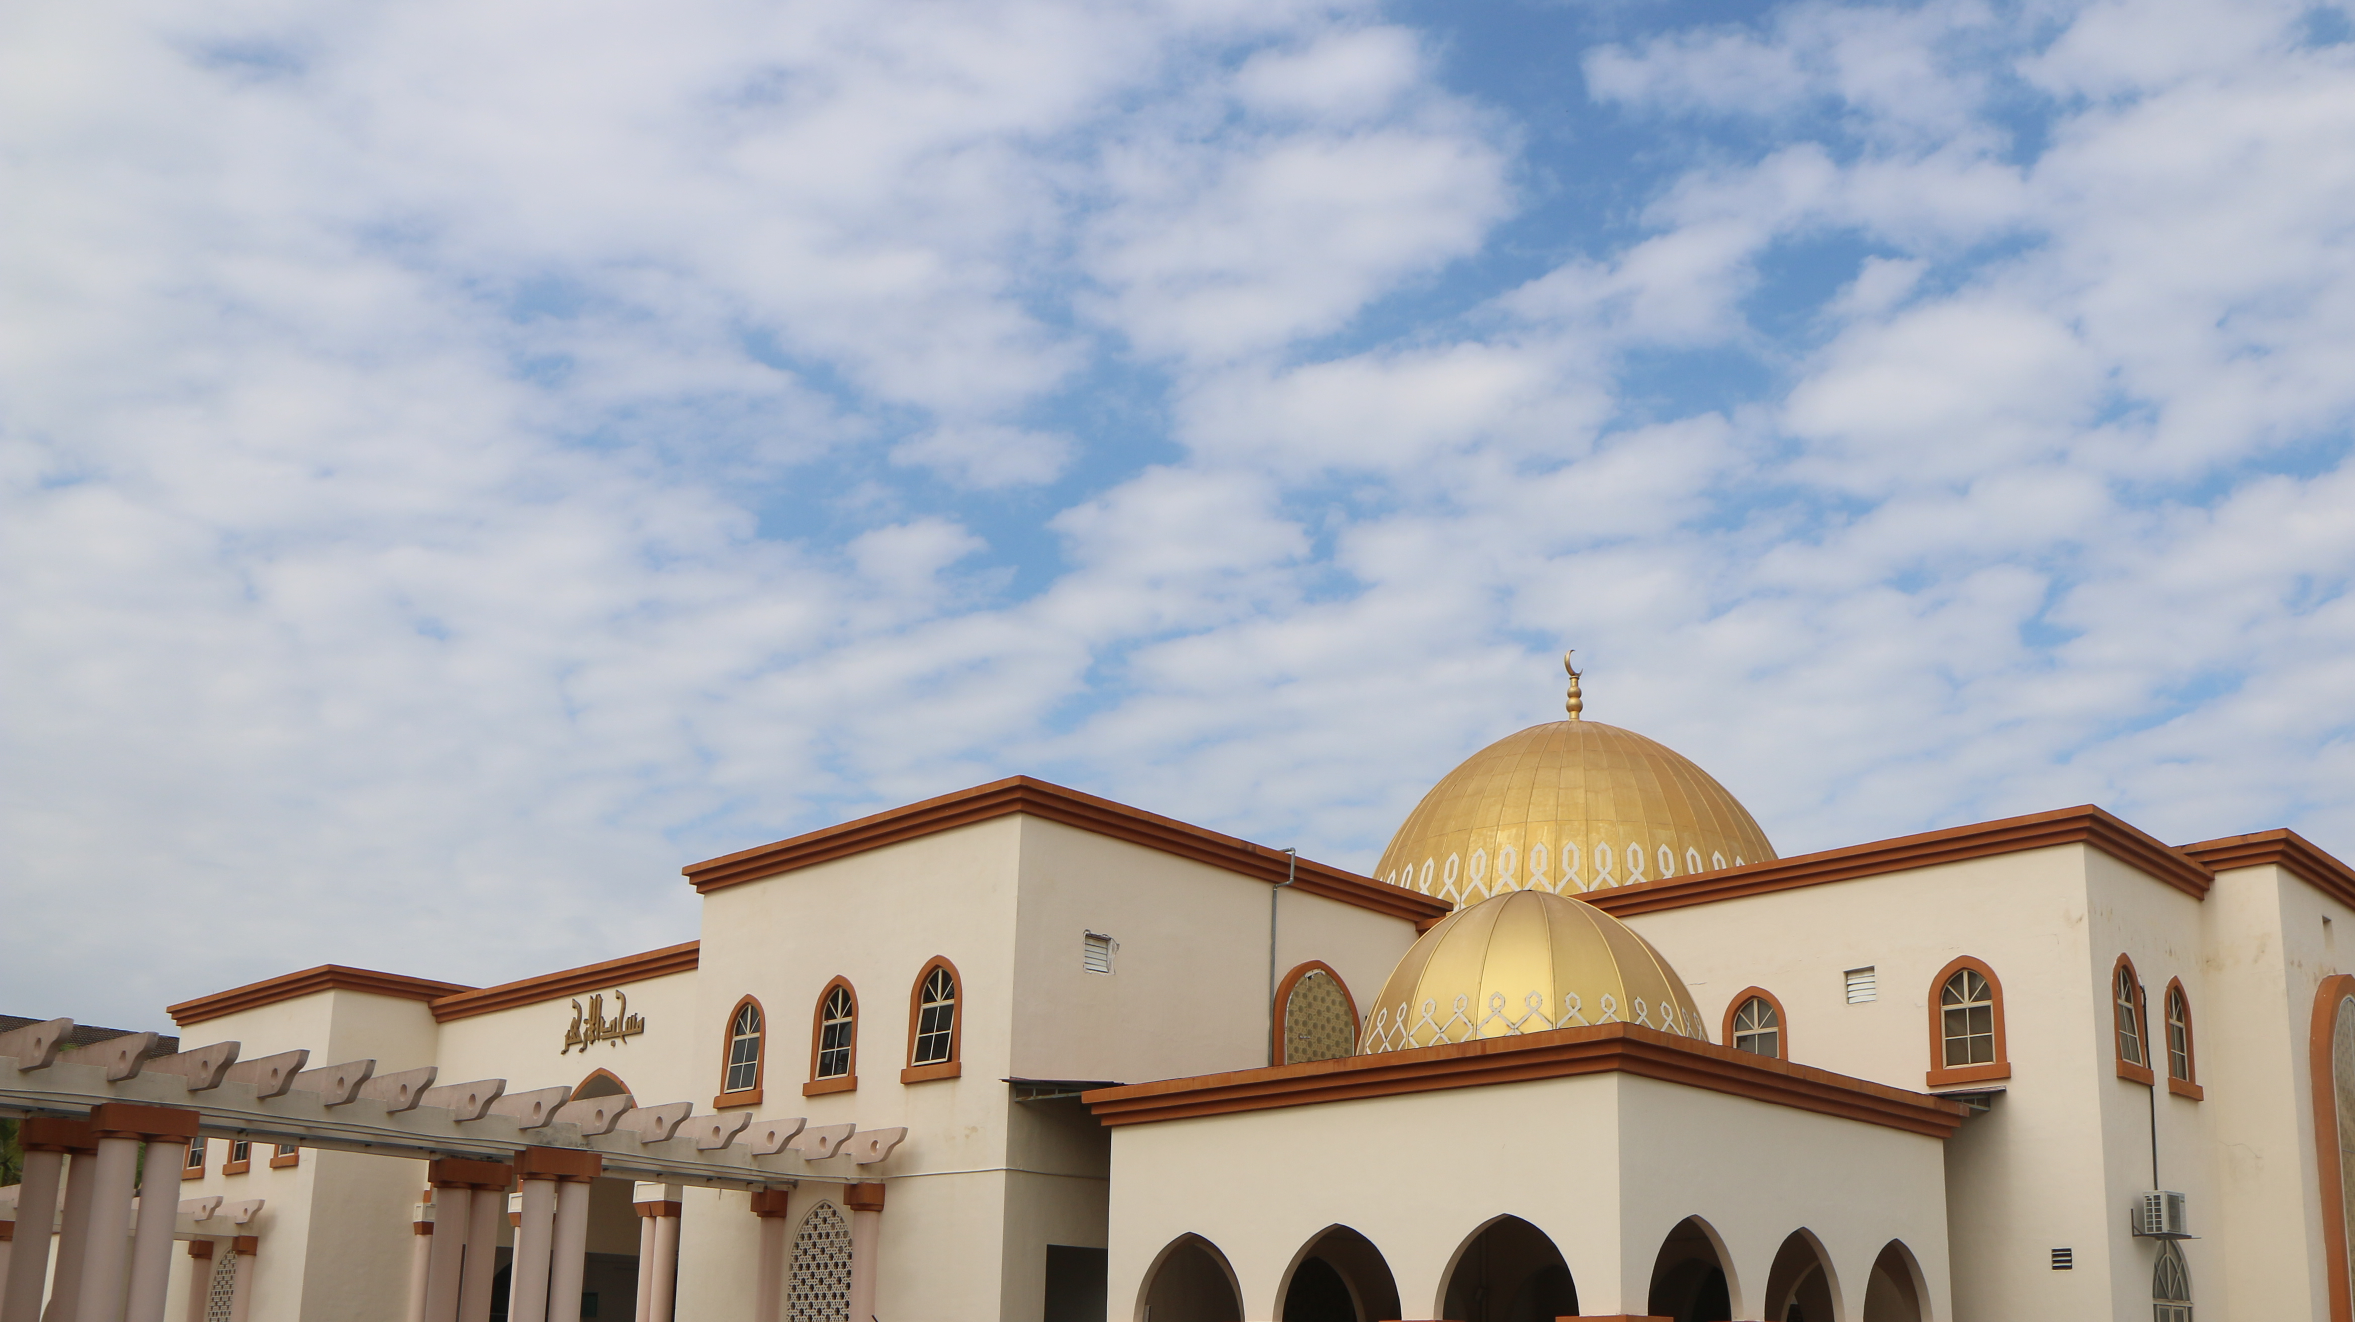

shareMasjid

Slide 132

& Firestore Auth

Slide 133


t10 Firebase (setup)

Slide 134

github.com/khirulnizam/ionic5 wasap.my/60129034614

Slide 135

Serverless option using Firebase
Serverless computing is a method of providing backend services on an as-used basis
A Serverless provider allows users to write and deploy code without the hassle of worrying about the underlying infrastructure
Scalable - the serverless vendor handles all of the scaling on demand
Simplified backend code
Quicker turnaround

Slide 136

JSON Concept
JSON: JavaScript Object Notation.
JSON is a lightweight data-interchange format
JSON format is text only, it can easily be sent to and from a server.

Slide 137
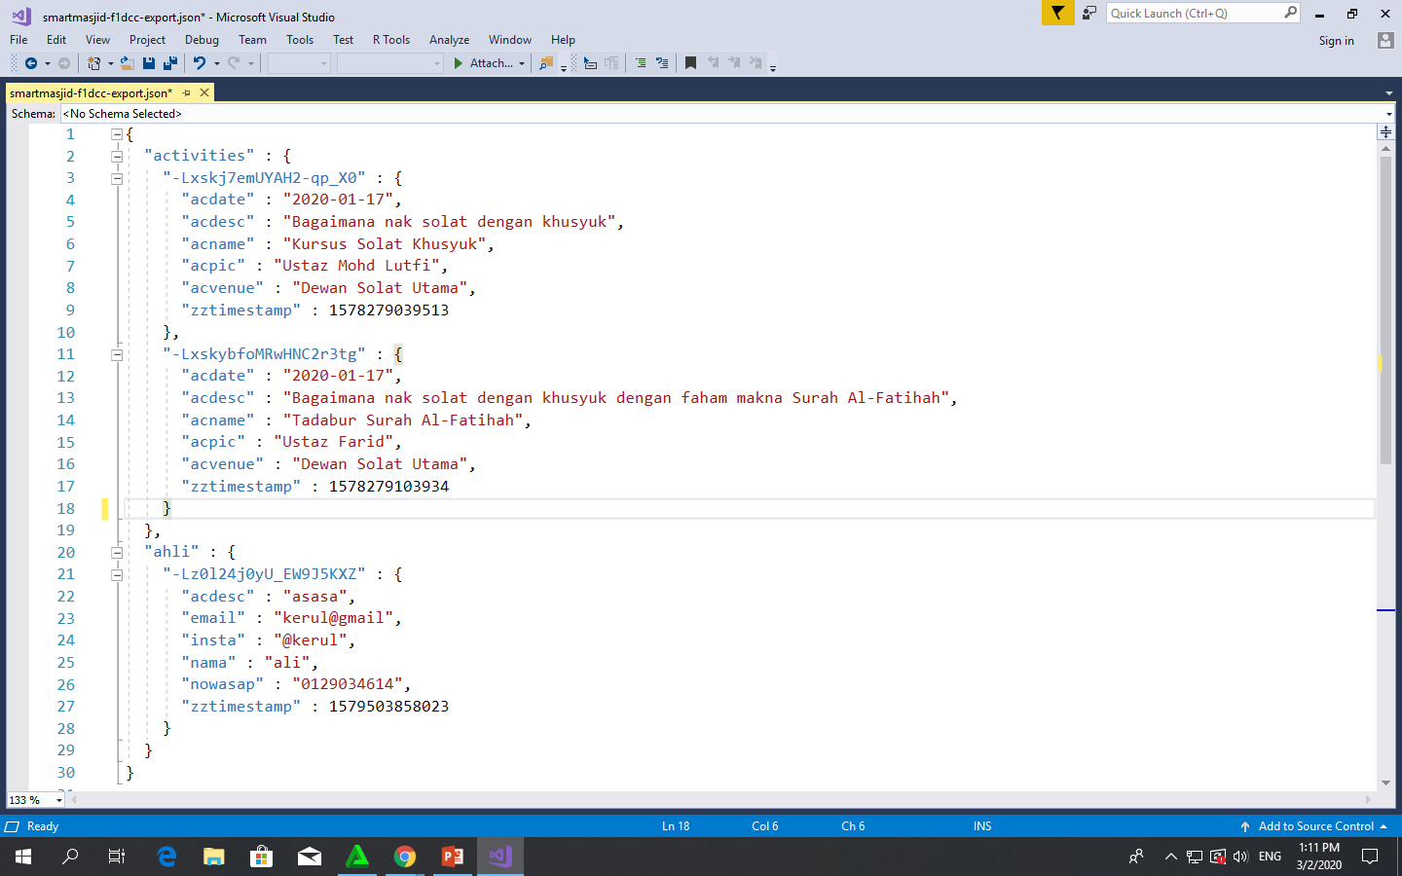
Play.google.com
JSON format example as applied in Firebase

Slide 138
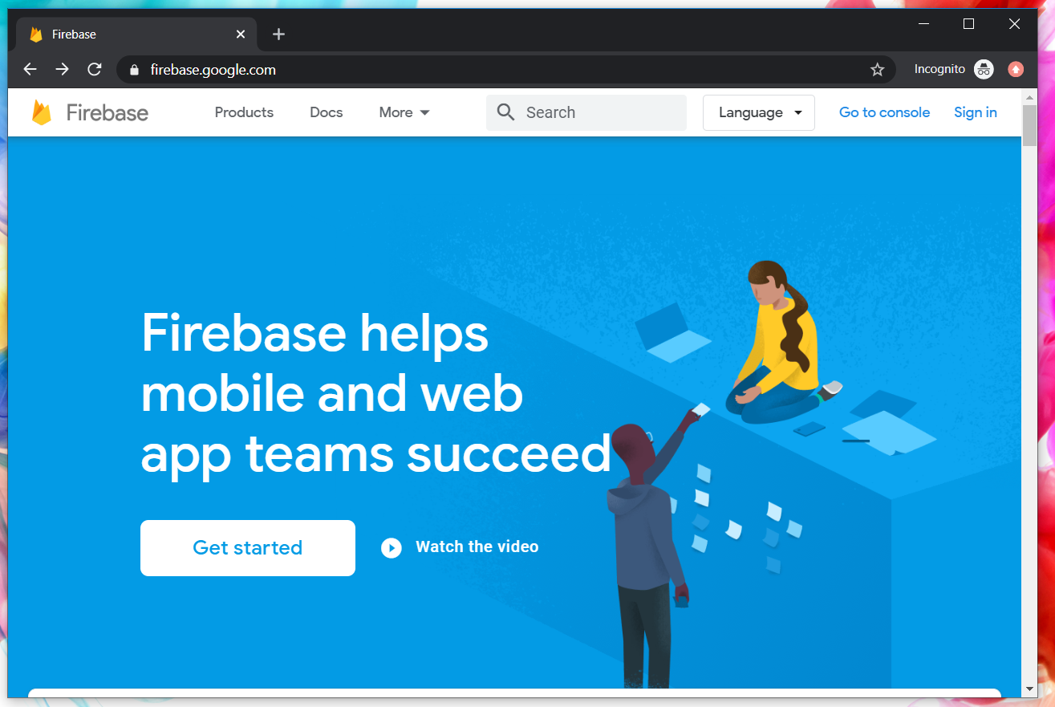
Google Firebase : Console
https://console.firebase.google.com/

Slide 139
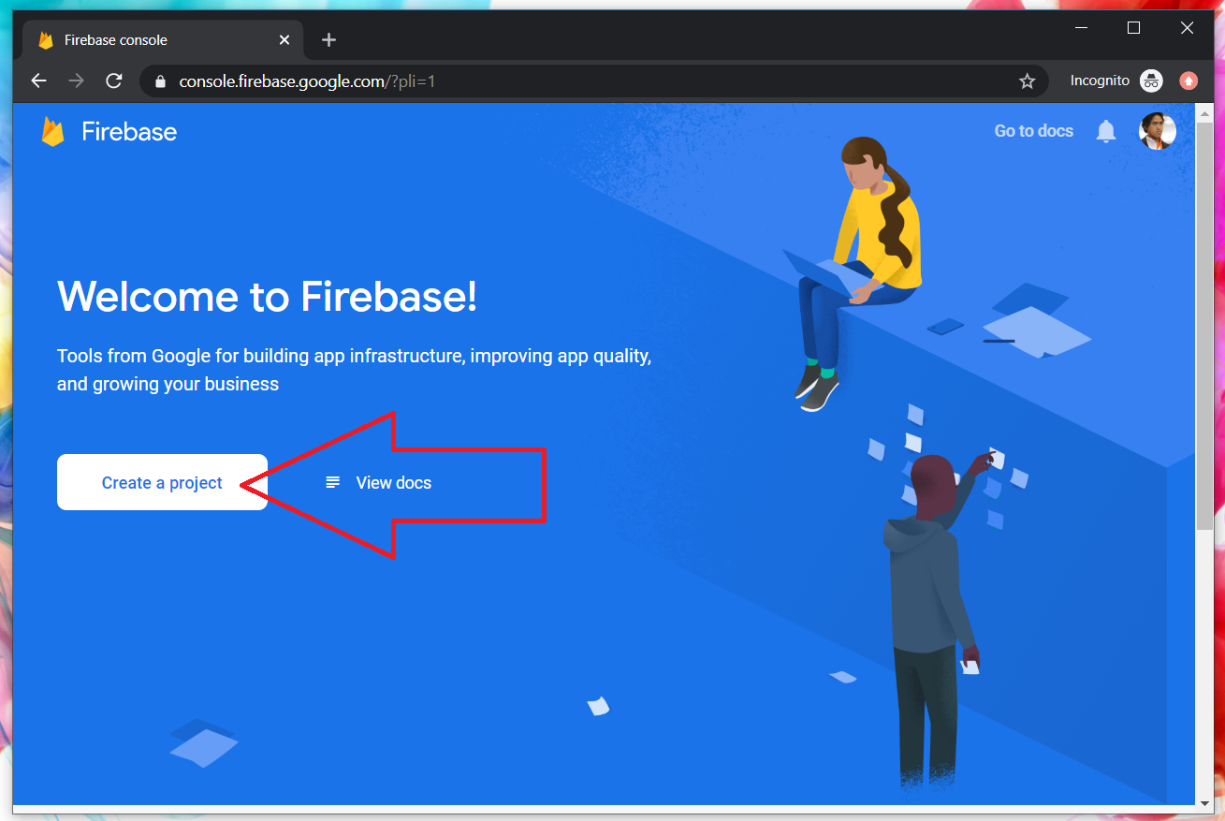
Google Firebase : Create new project

Slide 140
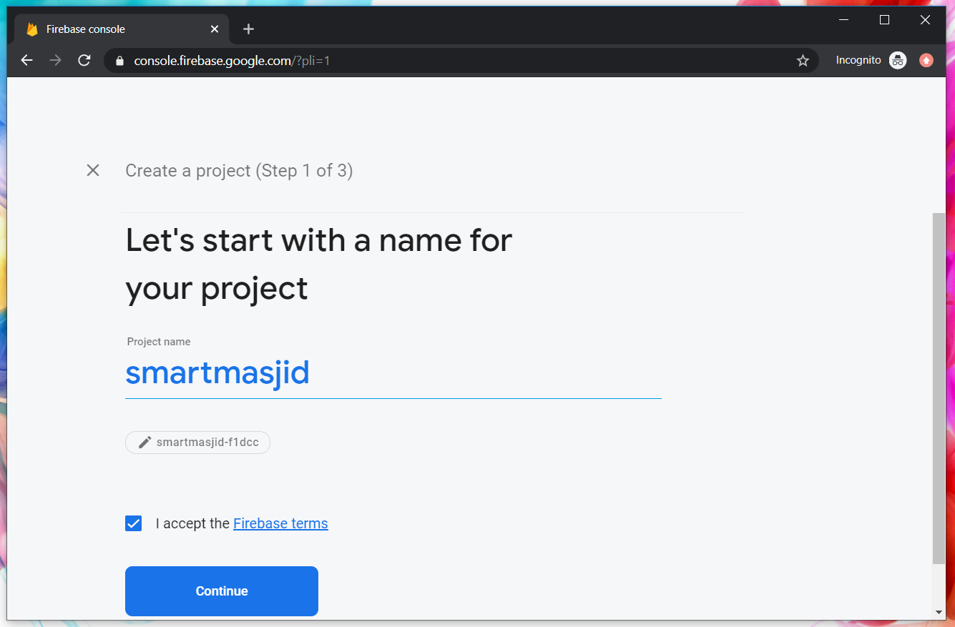
Google Firebase : Project name
sharefstm

Slide 141
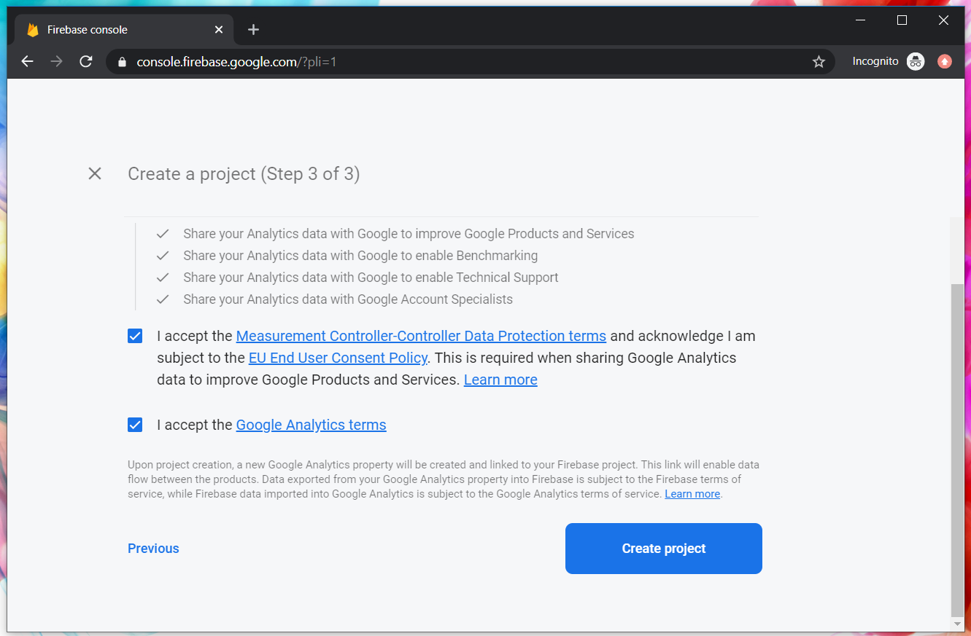
Google Firebase : Accept T&C

Slide 142
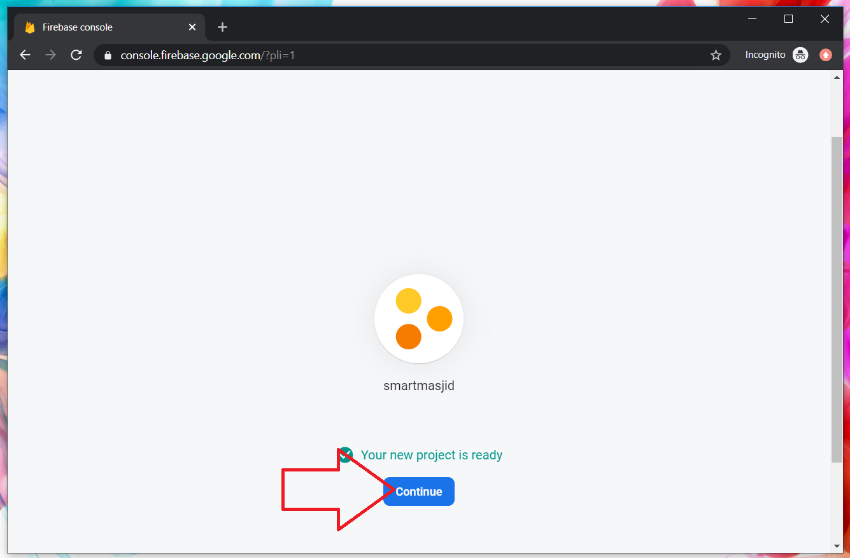
Google Firebase : Project ready and continue
makanapps

Slide 143
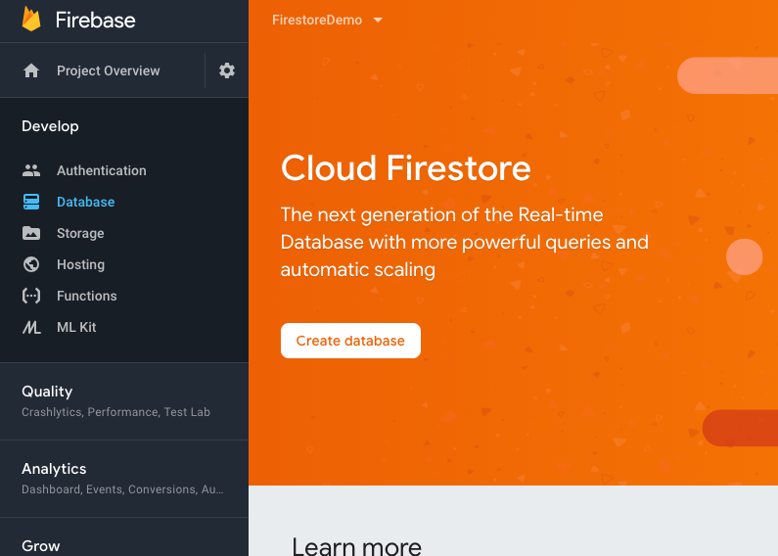
Google Firebase : Firestore database, automatic scaling

Slide 144

2
1
3

Slide 145

1
2

Slide 146

Google Firebase : Enable test mode

Slide 147

Google Firestore : add Firebase to app

Slide 148

Web Apps Firebase Configuration : Copy the highlighted

Slide 149

T11 Auth + Register
(daftar pengguna)

Slide 150

Create new Ionic project
ionic start sharefstm blank
Page 1: home

Slide 151

Filename src/app/home/home.page.html

Slide 152
Paste the Firebase configuration to environtment.ts
In environment.ts
…
export const environment : {
production: false,
firebaseConfig: {
apiKey: "AIzXXXXXXXXXXXXXXXWZMPN90HFrp4",
authDomain: "test-projeXXXXXXX.firebaseapp.com",
databaseURL: "https://test-projeXXXXXXX.firebaseio.com",
projectId: "test-projeXXXXXXX7",
storageBucket: "test-projeXXXXXXXX.appspot.com",
messagingSenderId: "446XXXXXX105"
}
};
…

Slide 153
Install AngularFirebase plugins
npm install firebase @angular/fire

Slide 154
Filename src/app/app.module.ts
//src/app/app.module.ts
…
//firebase & auth
import { AngularFireModule } from '@angular/fire';
import { AngularFireAuthModule } from '@angular/fire/auth';
import { environment } from '../environments/environment';
…
imports: [BrowserModule, IonicModule.forRoot(), AppRoutingModule,
//firebase & auth
AngularFireAuthModule,
AngularFireModule.initializeApp(environment.firebaseConfig),
…

Slide 155
Create globally accessible functions in folder services
ionic g service services/firebase
import { AngularFireAuth } from '@angular/fire/auth';
…
export class FirebaseService {
constructor(
private afAuth: AngularFireAuth
) { }
registerUser(email, password) {
return new Promise<any>((resolve, reject) => {
this.afAuth.createUserWithEmailAndPassword(email, password)
.then(
res => resolve(res),
err => reject(err))
})
}

Slide 156

Add another page
ionic g page daftar
Page 2: daftar

Slide 157

Filename src/app/daftar/daftar.page.html

Slide 158

Filename src/app/daftar/daftar.page.html

Slide 159

Filename src/app/daftar/daftar.page.ts

Slide 160

Filename src/app/daftar/daftar.page.ts

Slide 161


Slide 162
T12 Auth + Login
(pengesahan pengguna)

Slide 163
github.com/khirulnizam/ionic5 wasap.my/60129034614

Slide 164
Add globally accessible functions in folder services
ionic g service services/firebase
import { AngularFireAuth } from '@angular/fire/auth';
…
loginUser(email, password) { //function loginUser
return new Promise<any>((resolve, reject) => {
//authenticating with email & password
this.afAuth.signInWithEmailAndPassword(email, password)
.then(
res => resolve(res), //successful
err => reject(err)) //rejected
})
}//end loginUser
…

Slide 165

Add another page
ionic g page login
Page 3: login

Slide 166

Filename src/app/login/login.page.html

Slide 167

Filename src/app/login/login.page.html

Slide 168
Filename src/app/login/login.page.ts
…
cubalogin(email, password) {
this.fService.loginUser(this.email, this.password)
.then(res => {
console.log(res);
this.errorMessage = "";
//this.navCtrl.navigateForward('/dashboard');
}, err => {
this.errorMessage = err.message;
})
}//end cubalogin
…

Slide 169
github.com/khirulnizam/ionic5 wasap.my/60129034614

Slide 170




CRUDS

Slide 171

T13 Rekod Baharu
(insert new record)

Slide 172
github.com/khirulnizam/ionic5 wasap.my/60129034614

Slide 173
T14 Papar Senarai Rekod

Slide 174
github.com/khirulnizam/ionic5 wasap.my/60129034614

Slide 175
T15 Carian

Slide 176
github.com/khirulnizam/ionic5 wasap.my/60129034614

Slide 177
T16 Kemaskini
(update record)

Slide 178
github.com/khirulnizam/ionic5 wasap.my/60129034614

Slide 179
T17 Padam
(delete record)

Slide 180
SQLite
Ionic 5 Modals and SQLite Tutorial: Build a Product Manager App | Techiediaries
Ionic SQLite Tutorial - codesundar

Slide 181
JSON Ionic
Ionic 5 HTTP POST with Angular by Example | Techiediaries
Loading Remote JSON Data with HTTP in Ionic | joshmorony - Learn Ionic & Build Mobile Apps with Web Tech

Slide 182

Pengujian apps pada Android Emulator

Slide 183

Download Android Studio https://developer.android.com/studio

Slide 184

File -> New -> New Project

Slide 185

Package name

Slide 186

Tools -> AVD Manager

Slide 187

+ Create Virtual Device

Slide 188

Minimal resolution device

Slide 189

Choose available Android system image

Slide 190

If system image not yet available
Download Android
system image for
1.5GB! (estimation)

Slide 191

AVD name
Click Finish

Slide 192

Run Android Virtual Device

Slide 193

Run
Shift+F10

Slide 194

Apps is
Running
On AVD

Slide 195
Slides & materials github.com/khirulnizam/ionic5

Slide 196


Muatnaik Apps ke
Google Playstore
Fblive FSTM KUIS
11pg 6Nov 2020 (Jumaat)

Slide 197

←App ID

Slide 198

Play.google.com
Register for a developer ID
USD25 for life.
Another consideration: you need to pay through Google Wallet, using a credit card. https://play.google.com/apps/publish/

Slide 199
Playstore Graphic Materials
high-res icon. (size 512px x 512px)
Featured graphic. (size 1024px x 500px)
at least 2 non-Android TV screenshots. (2 screenshot images. Min length for any side: 320px)

Slide 200

Samples of graphic materials & signed bundle/APK

Slide 201
Graphic materials github.com/khirulnizam/ionic5

Slide 202



Slide 203


bit.ly/m-mathurat
(ionic)

Slide 204
https://ionicframework.com/docs/cli/commands/cordova-resources
Graphic materials
resources/icon.png (with size 1024x1024)
resources/splash.png (with size 2732x2732)

Slide 205

https://ionicframework.com/docs/cli/commands/cordova-resources
Graphic materials
resources/icon.png (with size 1024x1024)
resources/splash.png (with size 2732x2732)
(create folder resources)
splash.png
(2732x2732px)
icon.png (1024x1024px)

Slide 206
https://ionicframework.com/docs/cli/commands/cordova-resources
Commands - CLI
ionic cordova resources

Slide 207

Ionic cordova resources
(created after ionic cordova resources)

Slide 208
In file package.json add
"scripts": {
…
"resources":"cordova-res --skip-config --copy",
…
}

Slide 209
ionic capacitor add android
ionic build
npm install jetifier
npx jetifier
npx cap sync android
npx cap open android

Slide 210


Build, copy and open in Android Studioclz
ionic capacitor add android (sekiranya belum)
ionic build
npx cap sync android
npm install capacitor-resources -g
cordova-res --skip-config --copy
npx cap open android
Run apps in Android Studio
cordova-res to copy icon/splash from resources to Android project res folder

Slide 211



Kursus Perisian Pejabat
FPTT UTEM (online)
30 Dis 2020
Pn Mahani Ma’mum

